Slide 1

By: Moamen Nasser saad Section 3 Bn 37 Submitted to Dr. Islam eshrah
Faculty of Engineering
Cairo University EECE Department
ELC 465
Advanced Microwaves

Slide 2
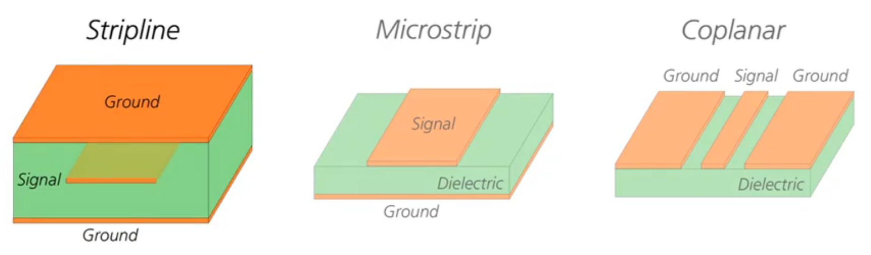
VERY PERI
Assignment 1 comparison of different TL types on PCB
1- Microstrip Line
2- Strip Line
3- CPW (coplanar waveguide)
Introducing the Pantone Color of the Year 2022. PANTONE 17-3938 Very Peri is a dynamic hue that blends the faithfulness and constancy of blue with the energy and excitement of red.
The four color palettes in this template feature Very Peri to help you express your ideas and convey the right mood. Read on to learn how to use these colors in any presentation.

Slide 3
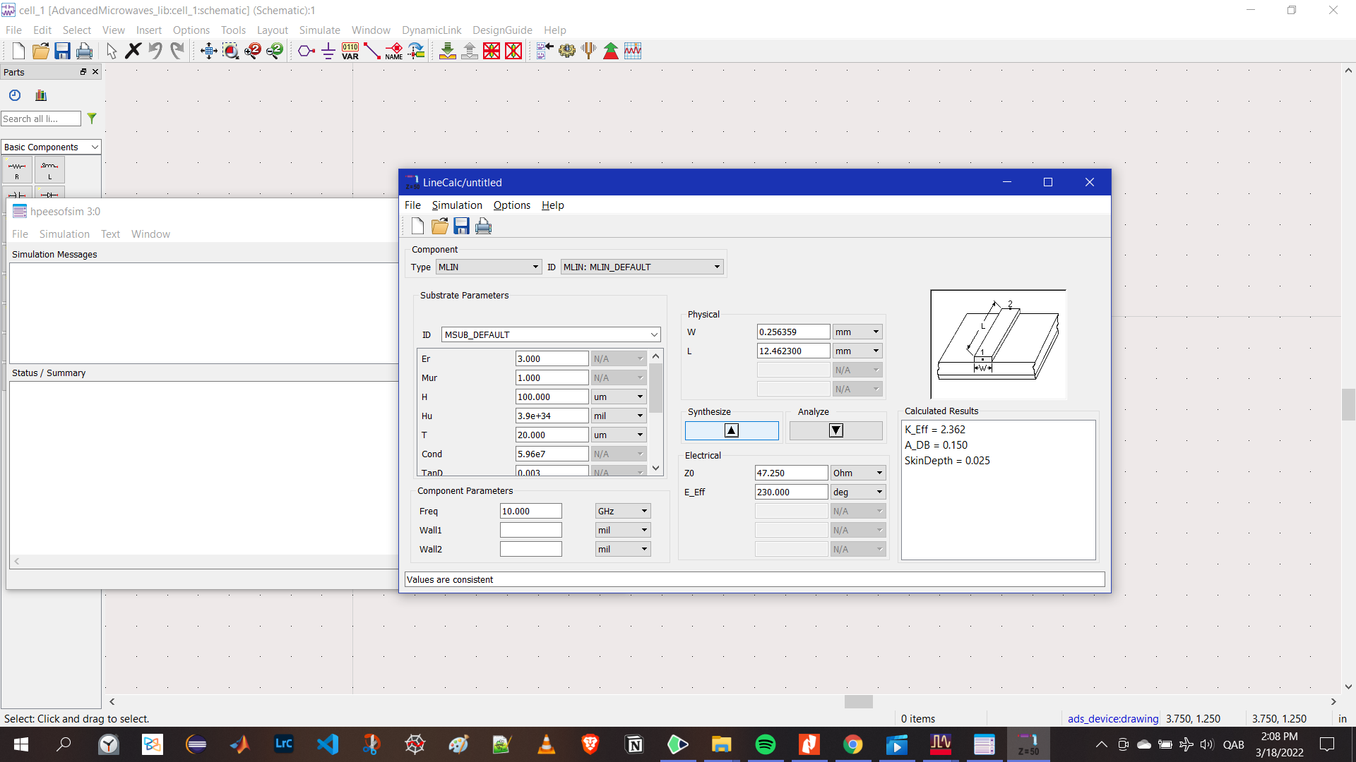
1-Microstrip line
Line calc to get the values of W and L
W = 0.2563 mm
L = 12.4632 mm

Slide 4
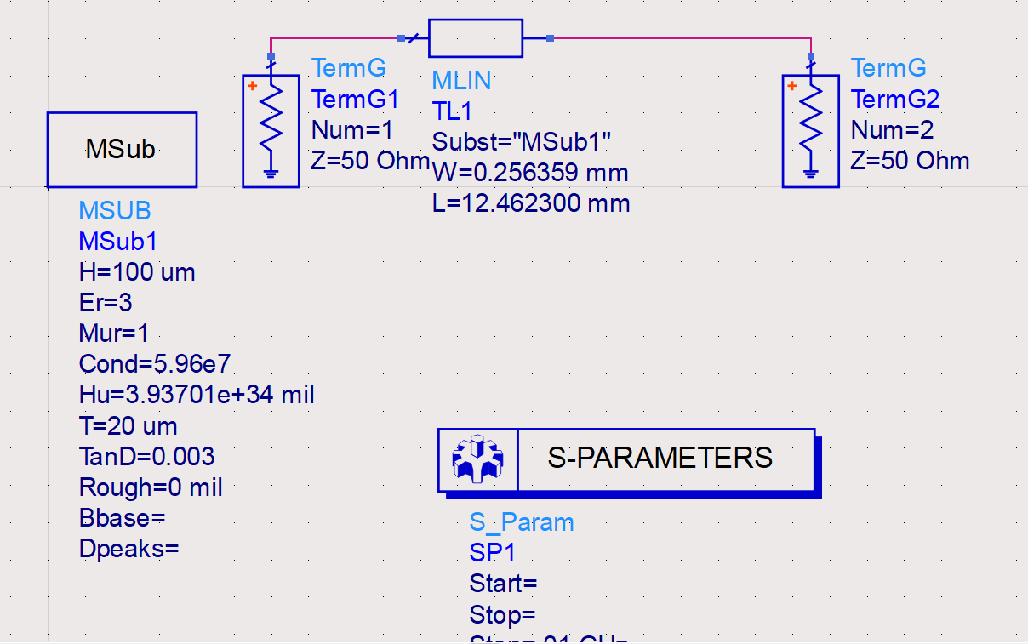
Schematic design

Slide 5
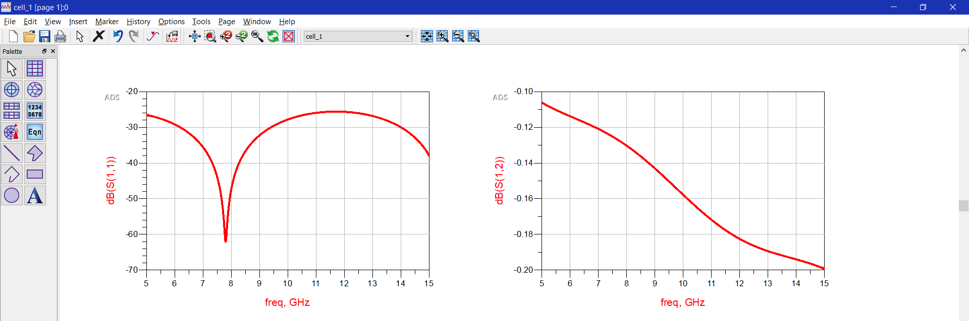
Values from schematic

Slide 6
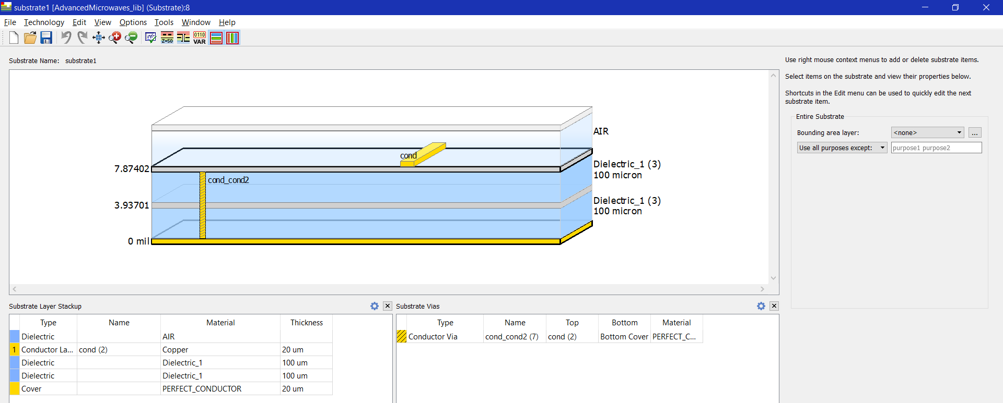
Via and layers

Slide 7
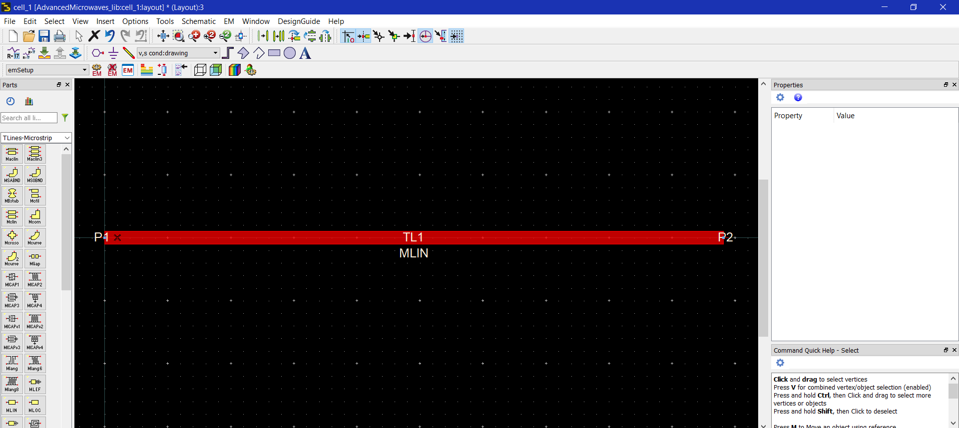
Pcb design

Slide 8
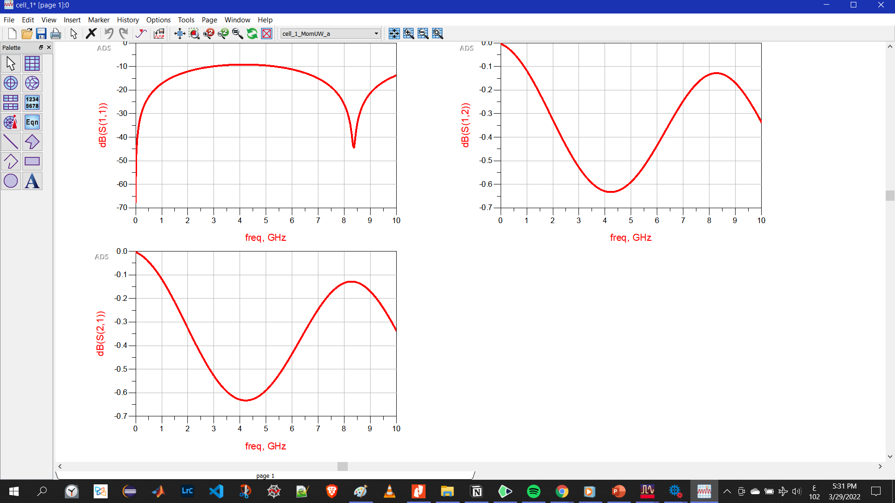
Loss values From pcb

Slide 9
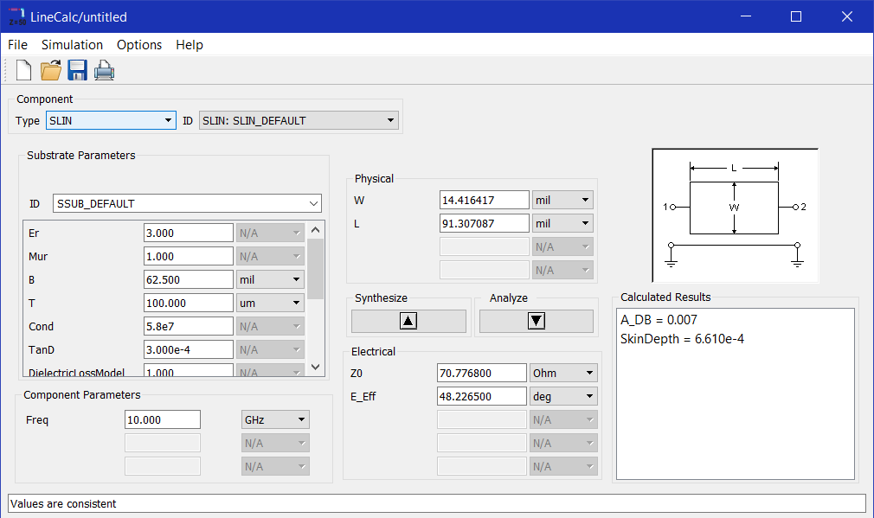
2- Strip line
Line calc to get the values of W and L
W = 14.416417 mil
L = 91.307087 mil

Slide 10
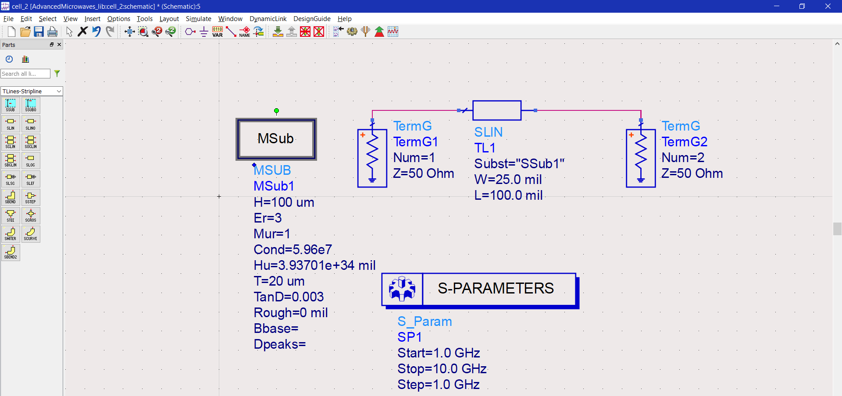
Schematic design

Slide 11
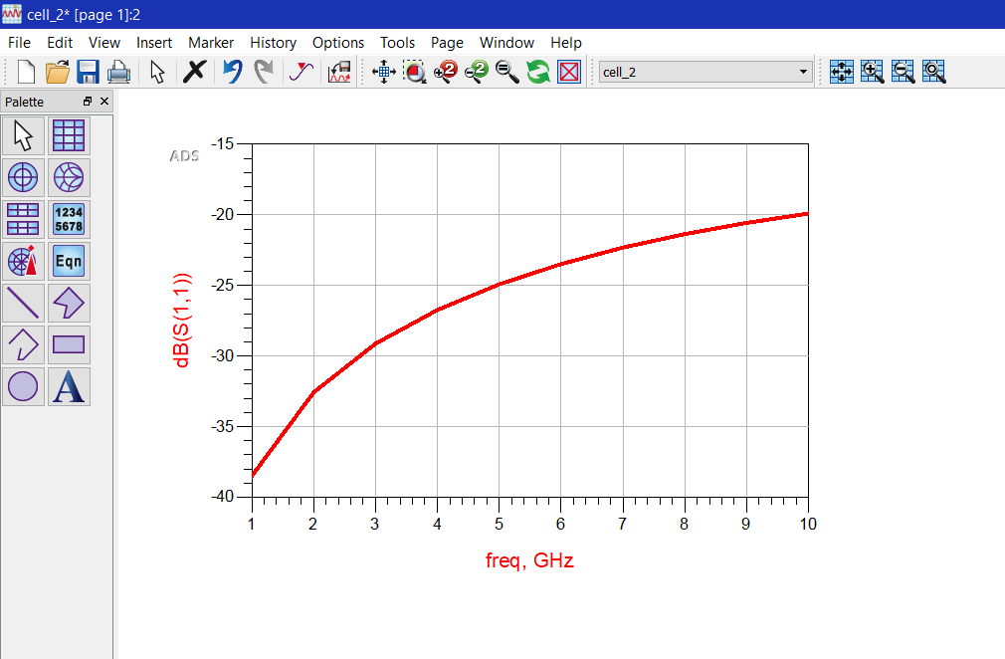
Losses values from schematic

Slide 12

Via and layers

Slide 13
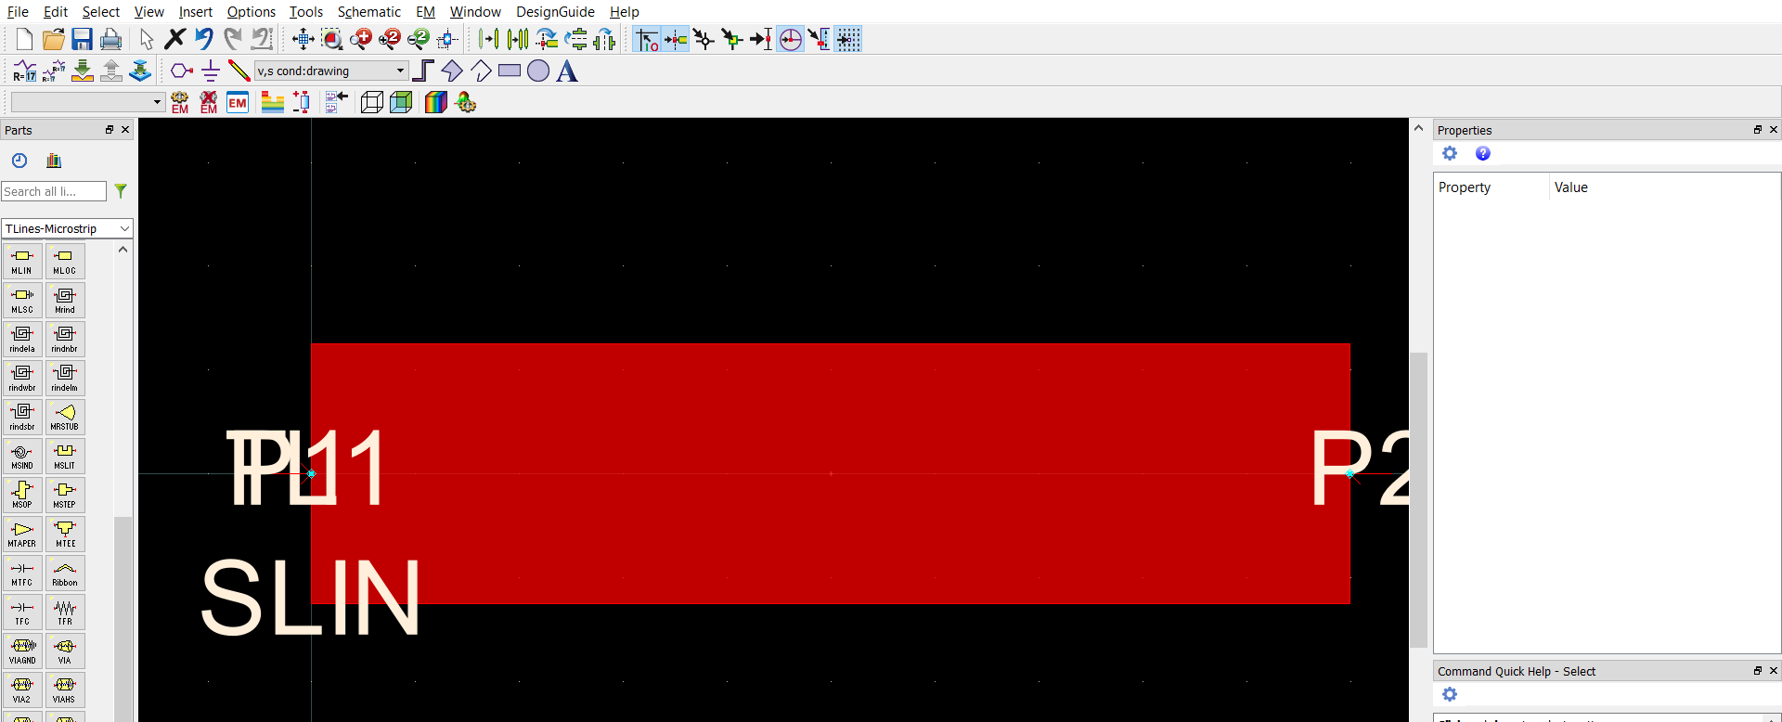
Pcb design
I am still learning ads and layout so this isn’t the final results
My GP not in analog

Slide 14
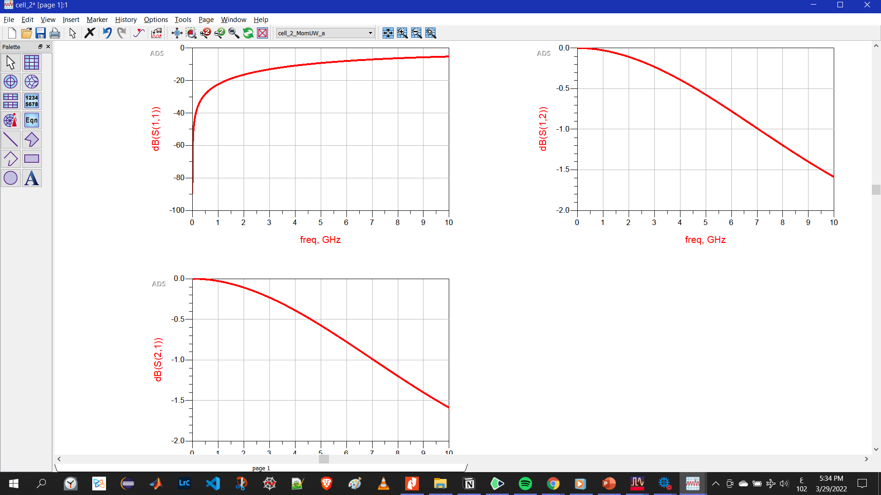
Loss values From pcb

Slide 15
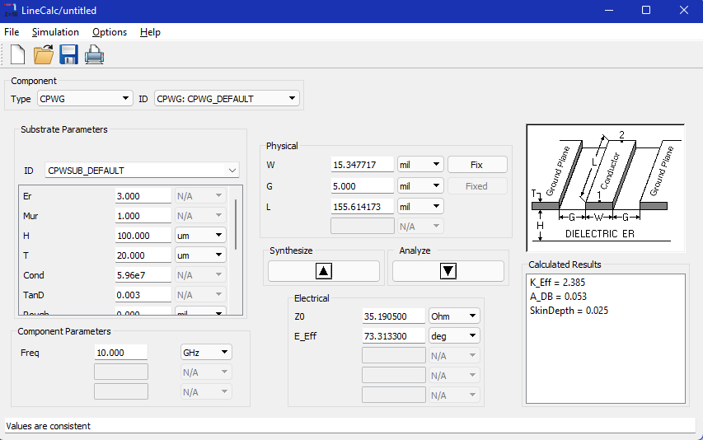
3- cpw
Line calc to get the values of W and L
W = 14.416417 mil
L = 91.307087 mil

Slide 16
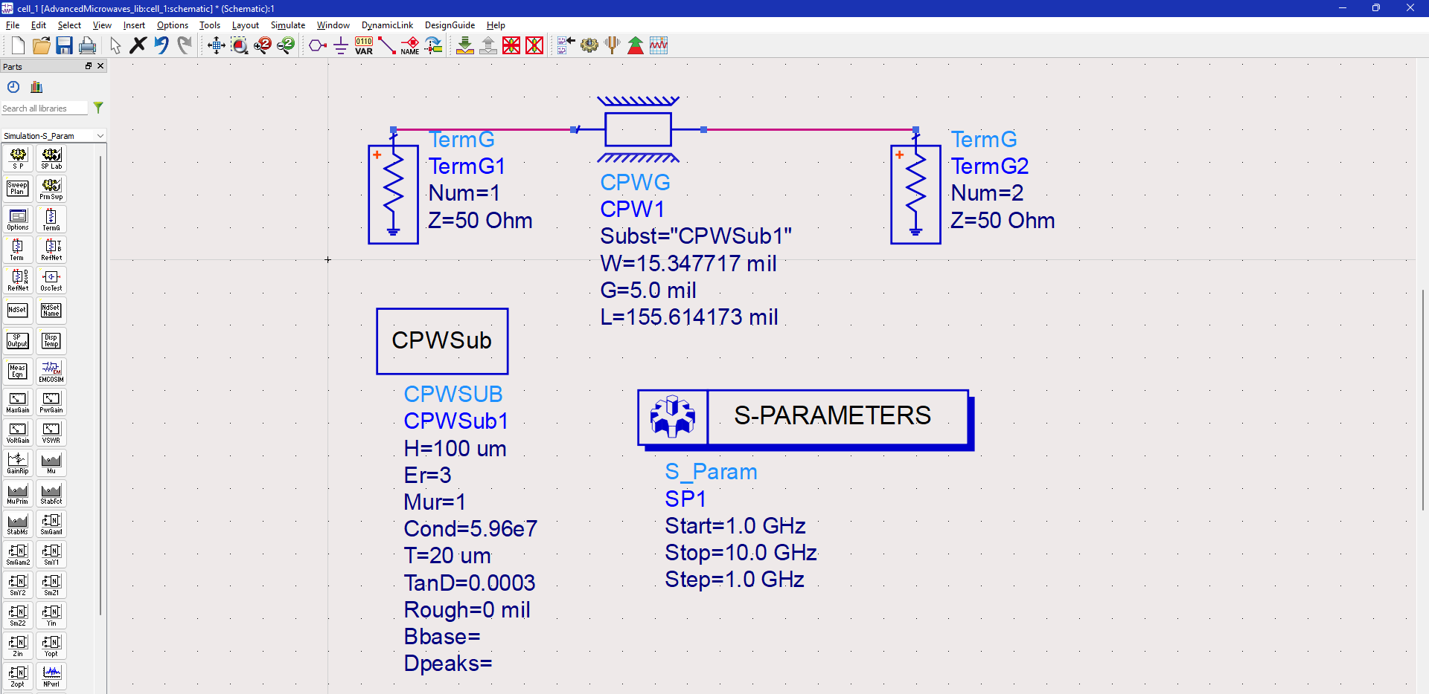
Schematic design

Slide 17
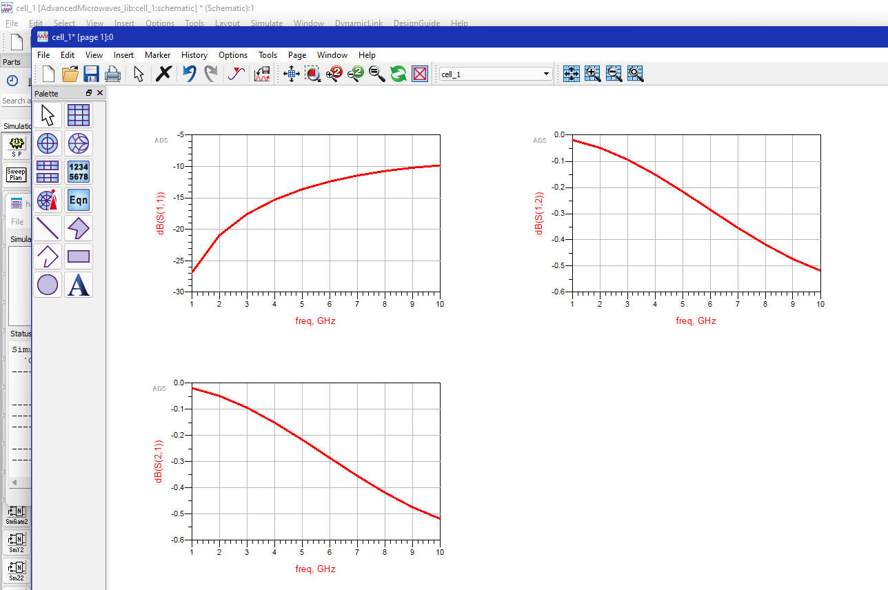
Losses values from schematic

Slide 18
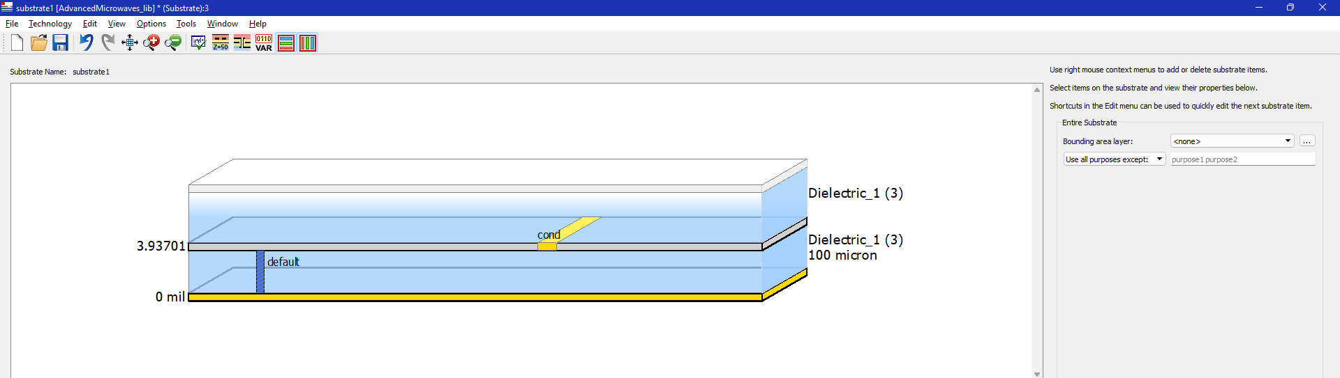
Via and layers

Slide 19
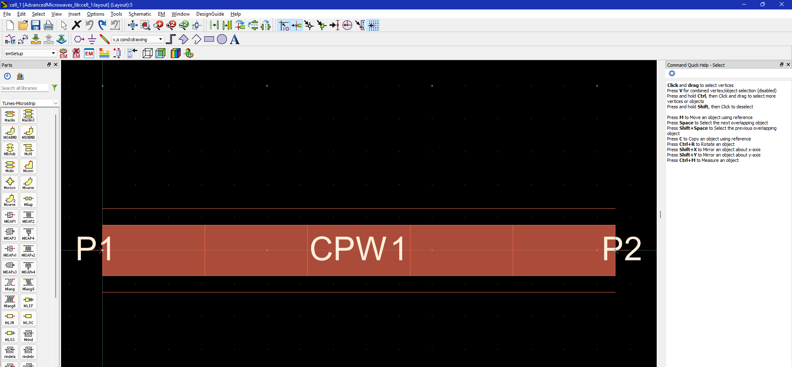
layout design

Slide 20
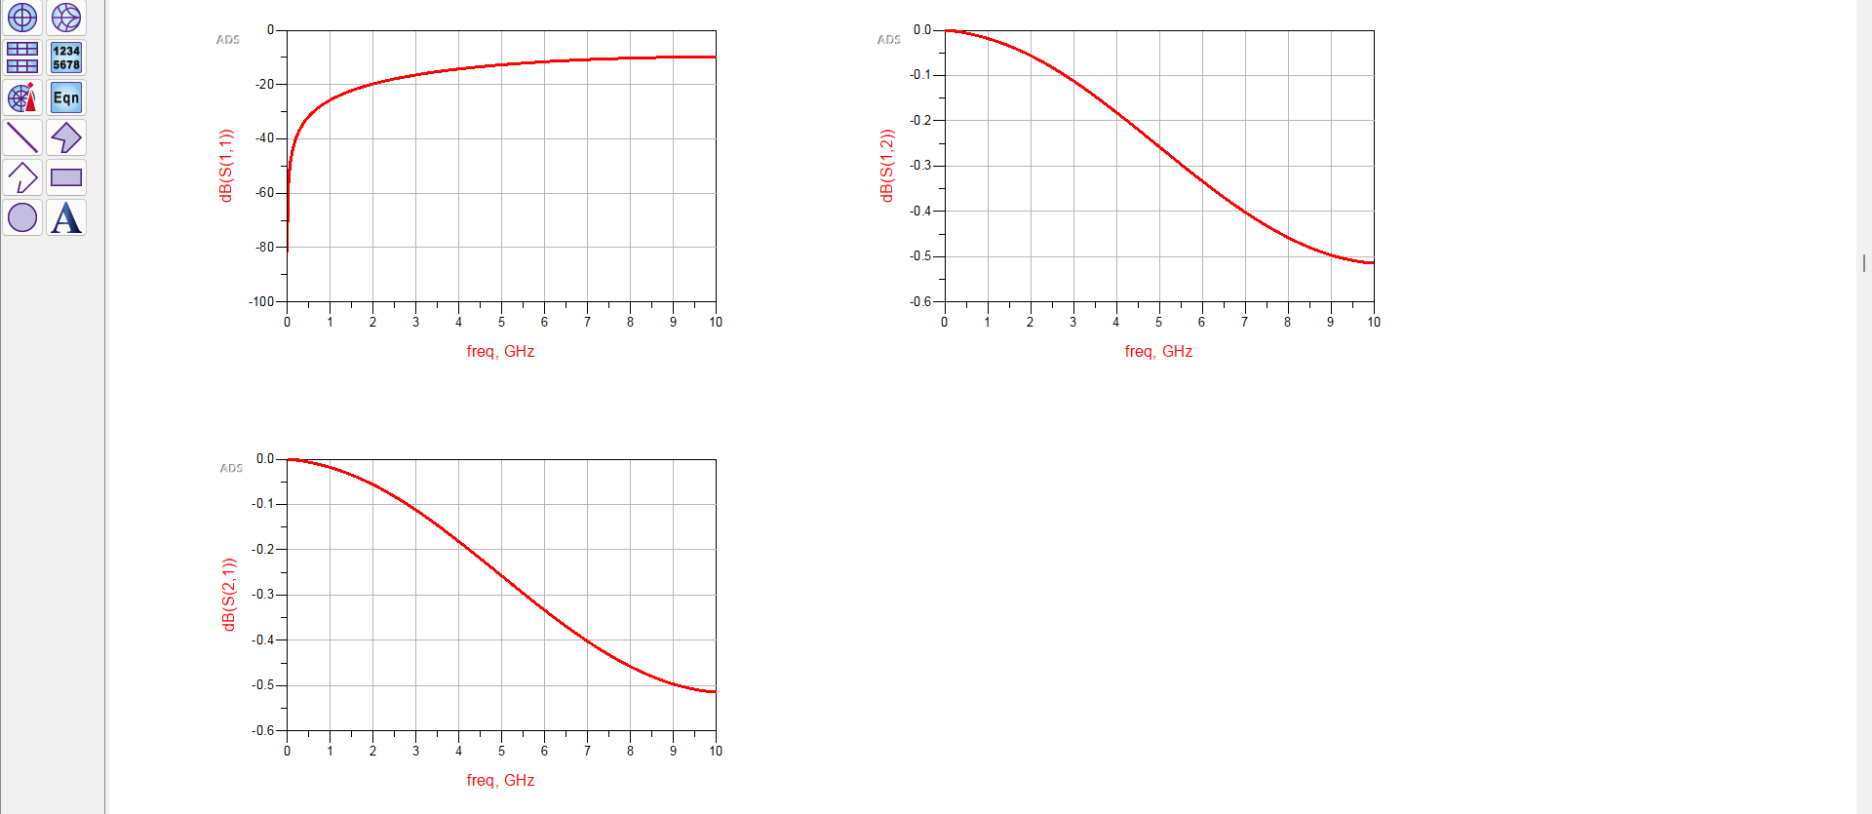
Loss values From layout

Slide 21
VERY PERI
Introducing the Pantone Color of the Year 2022. PANTONE 17-3938 Very Peri is a dynamic hue that blends the faithfulness and constancy of blue with the energy and excitement of red.
The four color palettes in this template feature Very Peri to help you express your ideas and convey the right mood. Read on to learn how to use these colors in any presentation.
Assignment 2
Mat-Lab Code

Slide 22
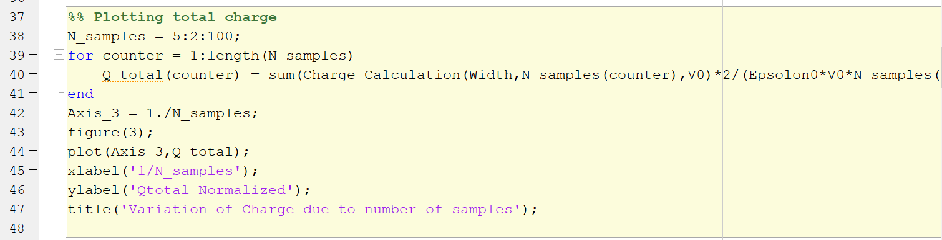
Assignment 2 mat lab code to determine the charge distribution on a charged conducting strip
Code is here for more info : for part 1: 1D My code for part 2: 2D
I have a problem in plotting graph number 3 in the code it doesn’t work
My code only plot 4 figures 1+2+4+5
I have to comment all the other plots to be able to plot it

Slide 23
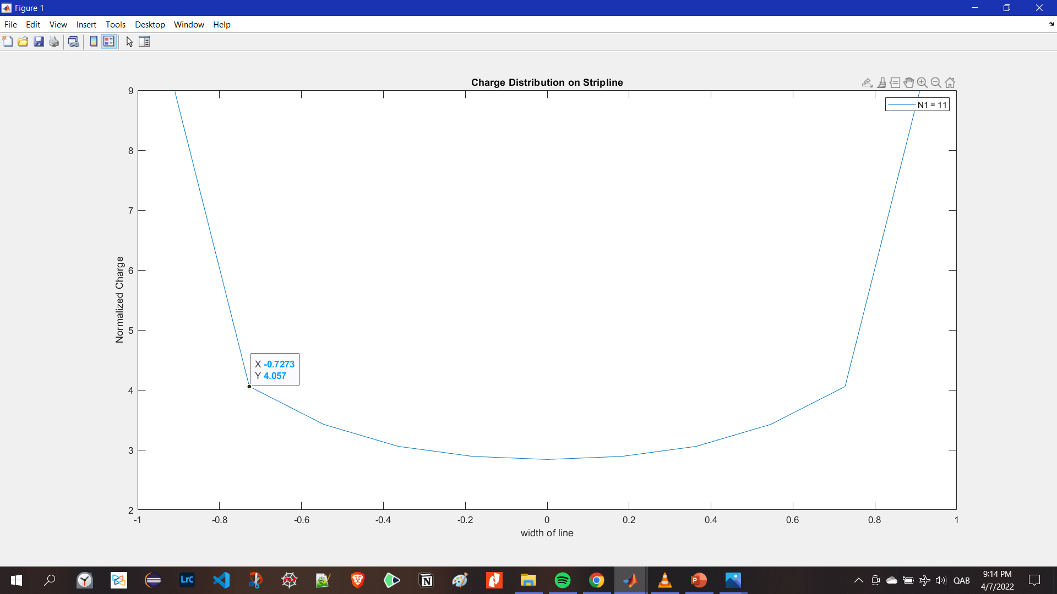
Charge distribution plot when N = 11

Slide 24
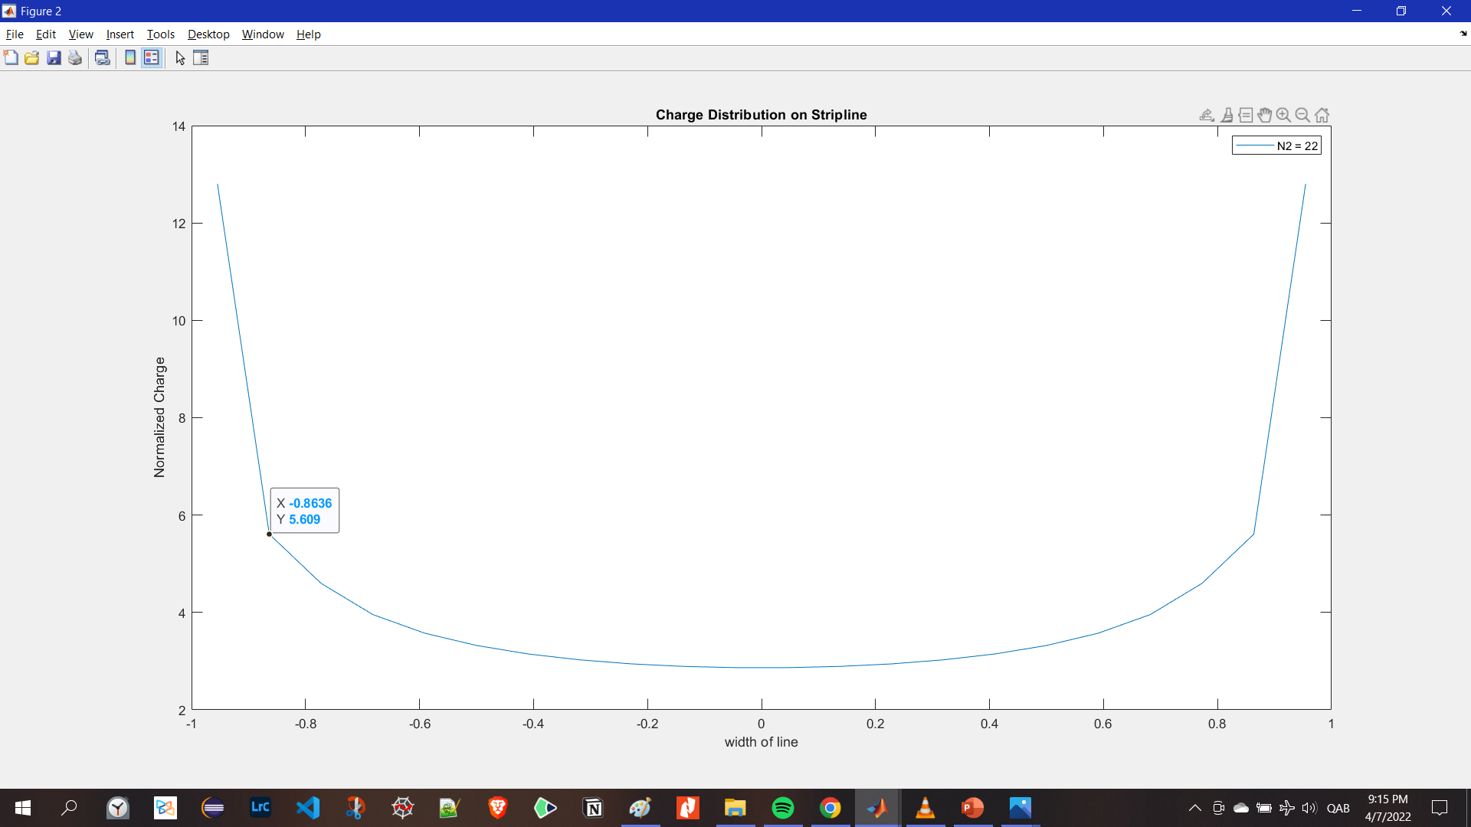
Charge distribution plot when N = 22

Slide 25
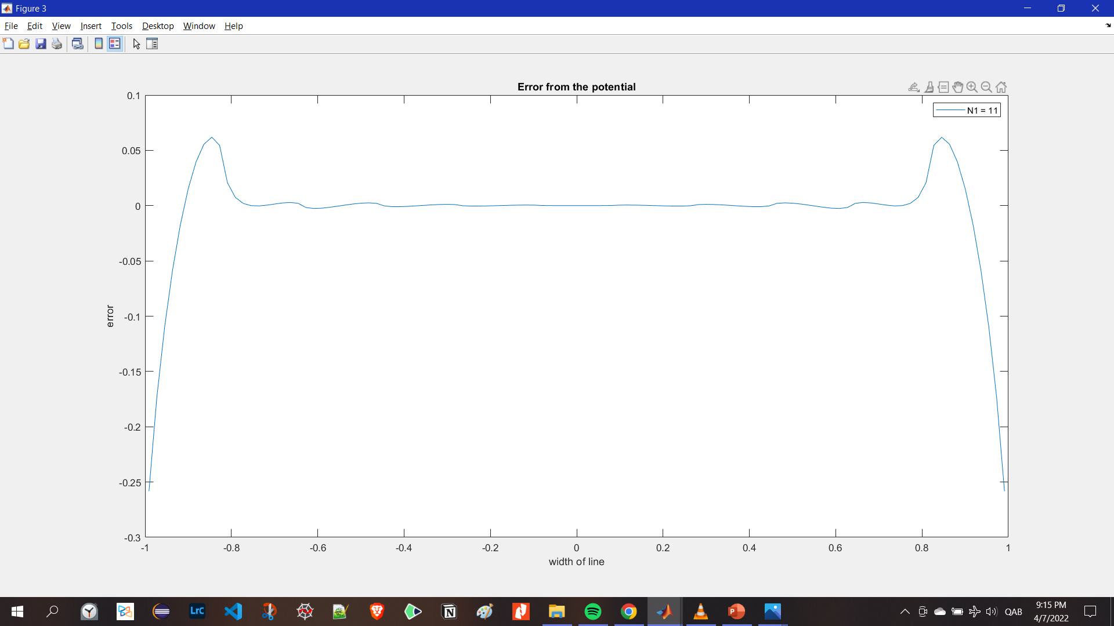
Error from the potential when n = 11

Slide 26

Error from the potential when n = 22

Slide 27
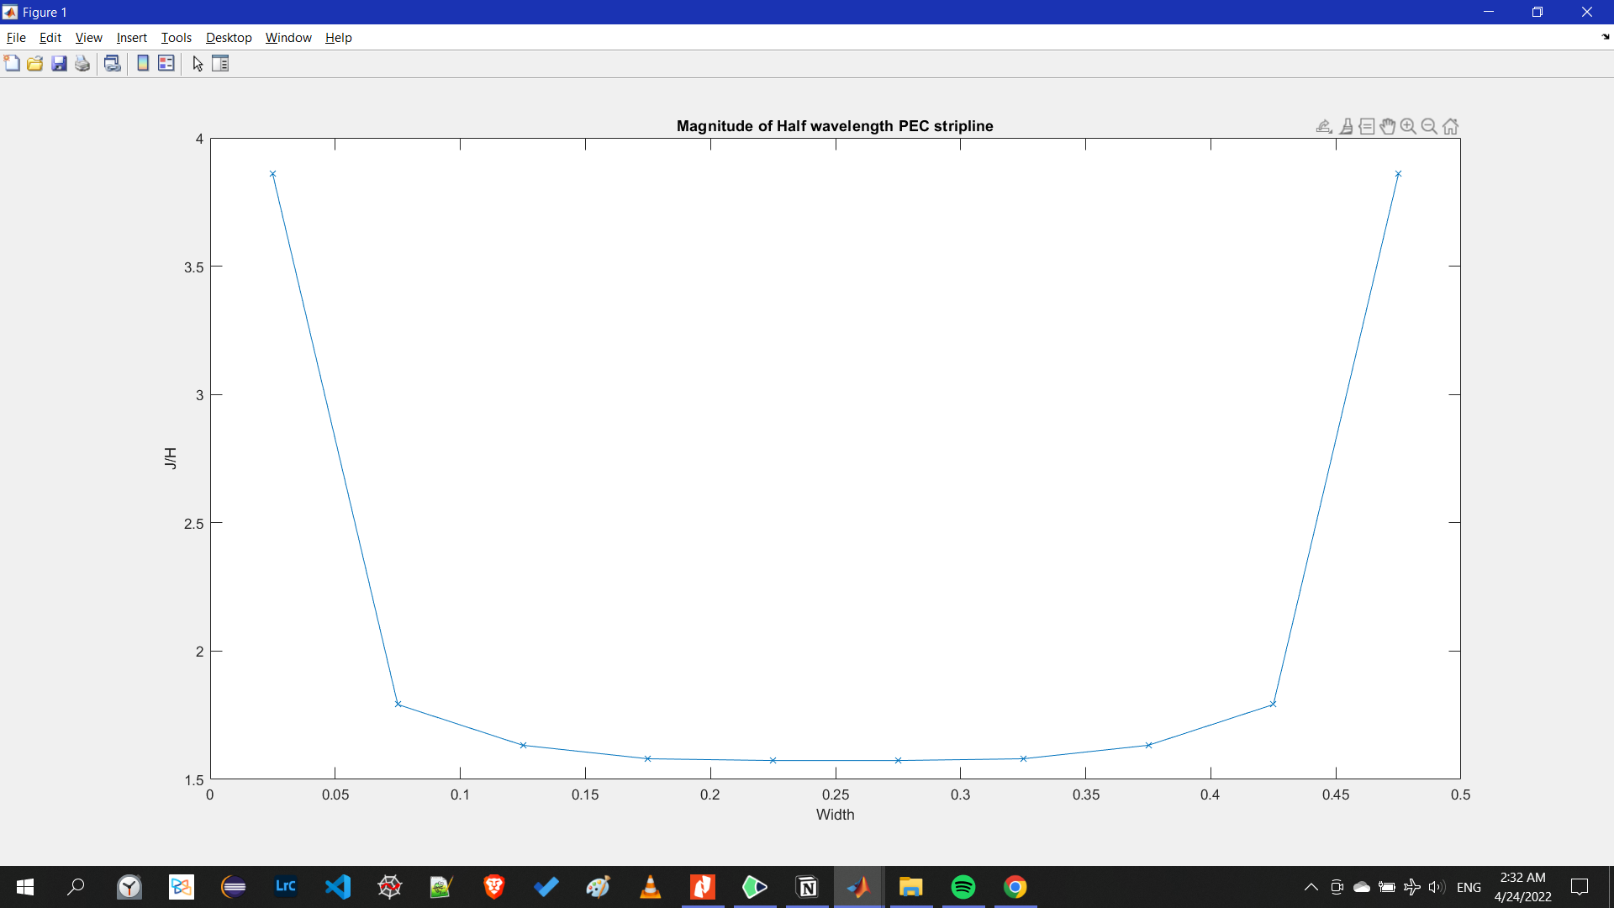
2D electromagnetic scattering from an arbitrary-shaped conducting object under TM illumination
Half Wavelength PEC:
Magnitude

Slide 28
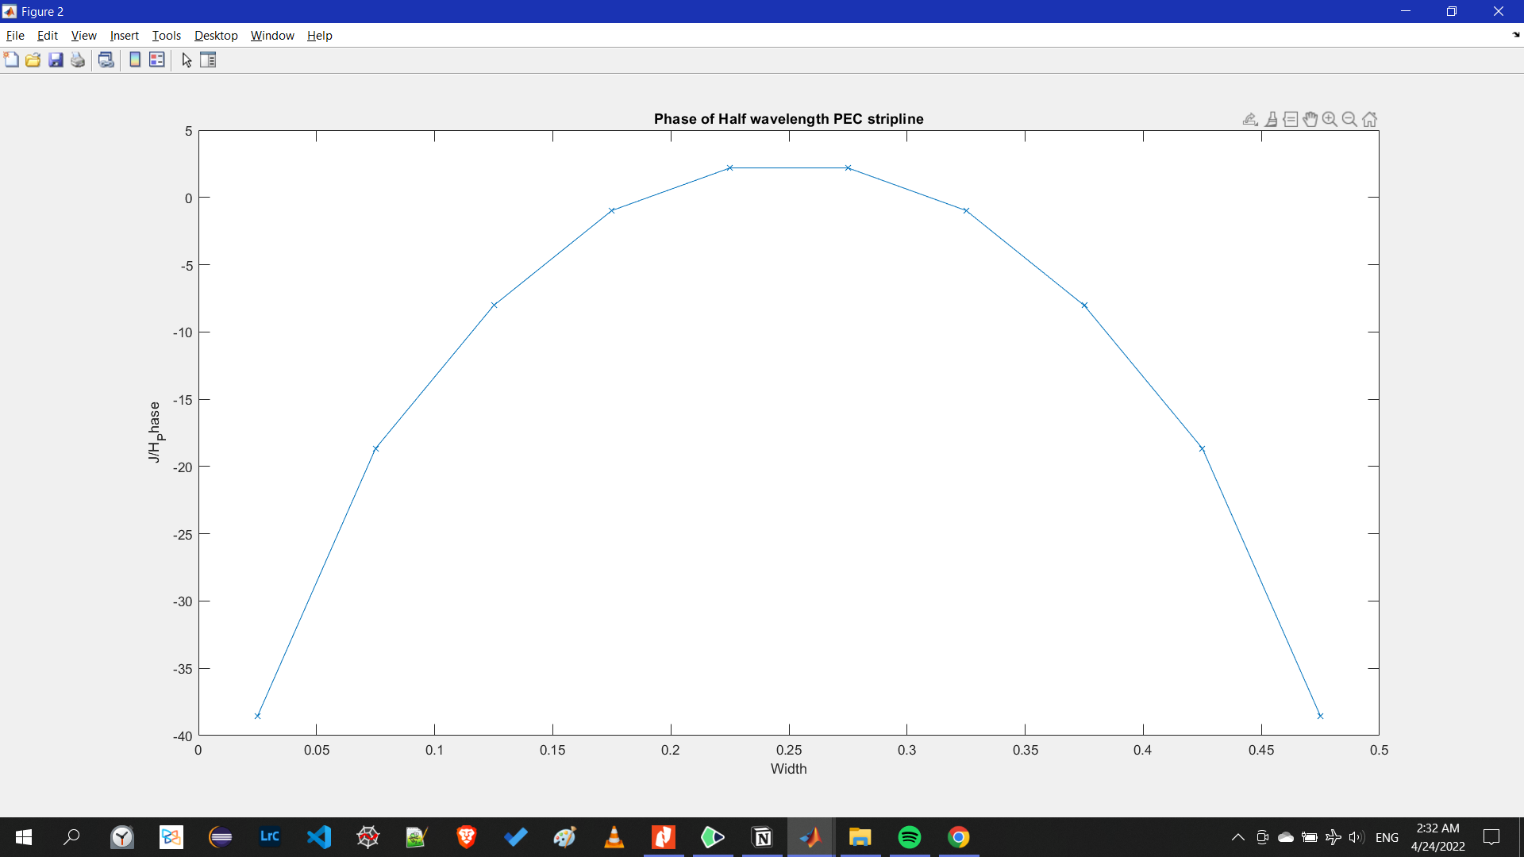
2D electromagnetic scattering from an arbitrary-shaped conducting object under TM illumination
Half Wavelength PEC:
Phase

Slide 29
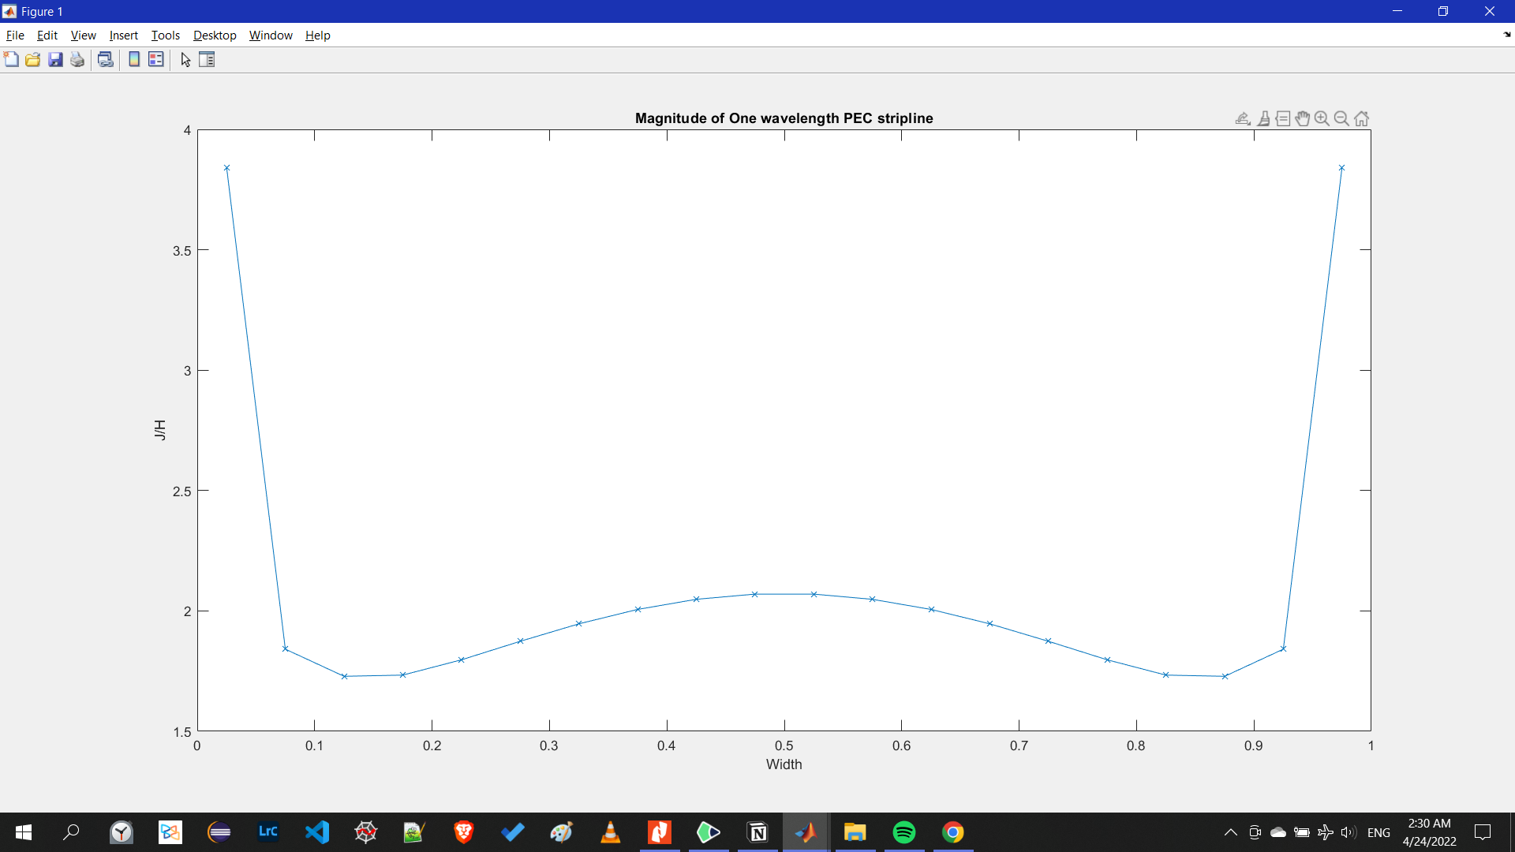
2D electromagnetic scattering from an arbitrary-shaped conducting object under TM illumination
One Wavelength PEC:
Magnitude

Slide 30
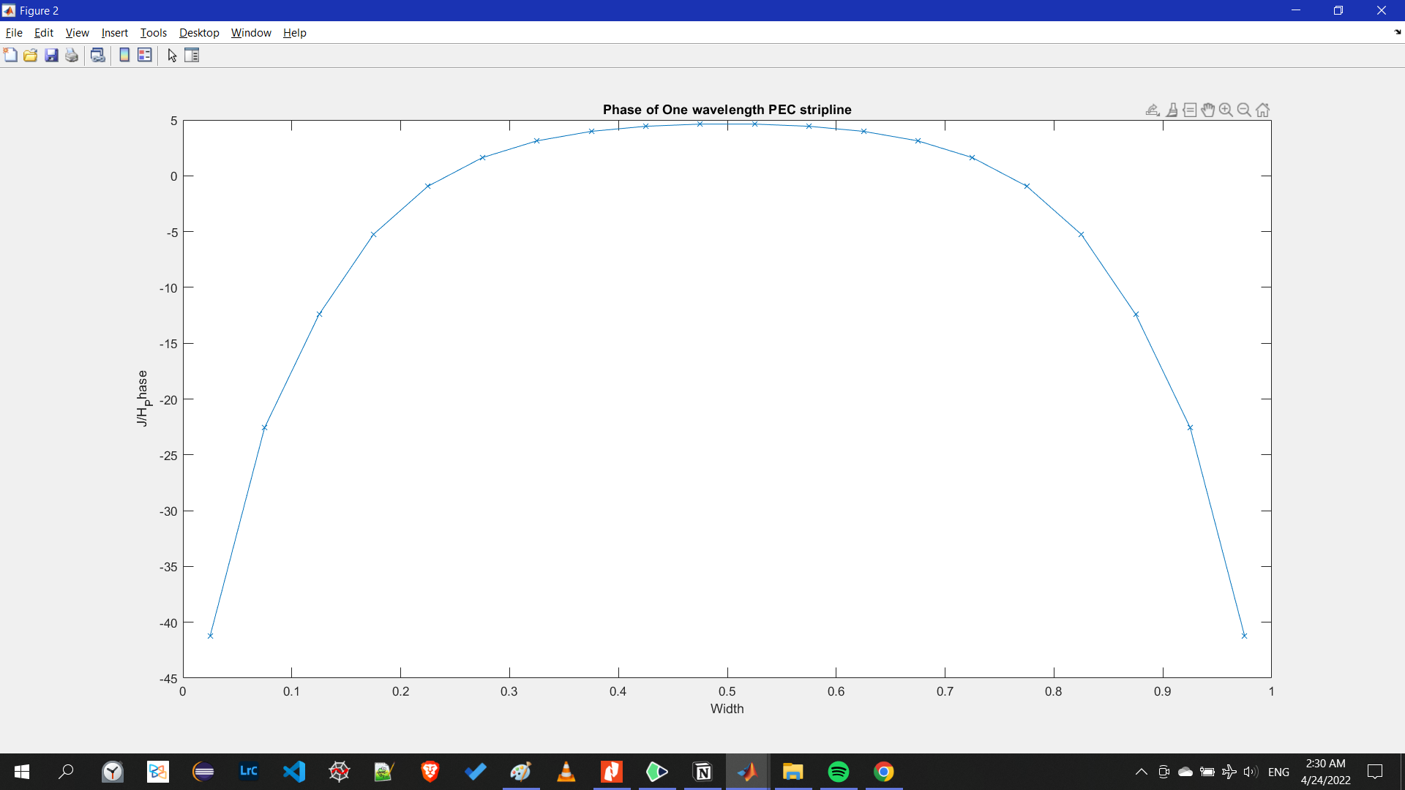
2D electromagnetic scattering from an arbitrary-shaped conducting object under TM illumination
One Wavelength PEC:
Phase

Slide 31
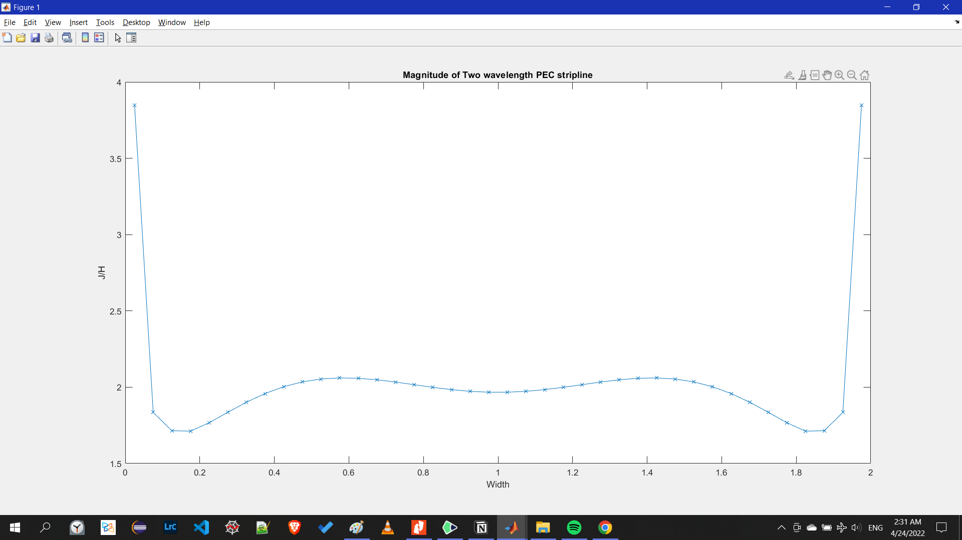
2D electromagnetic scattering from an arbitrary-shaped conducting object under TM illumination
Two Wavelength PEC:
Magnitude

Slide 32
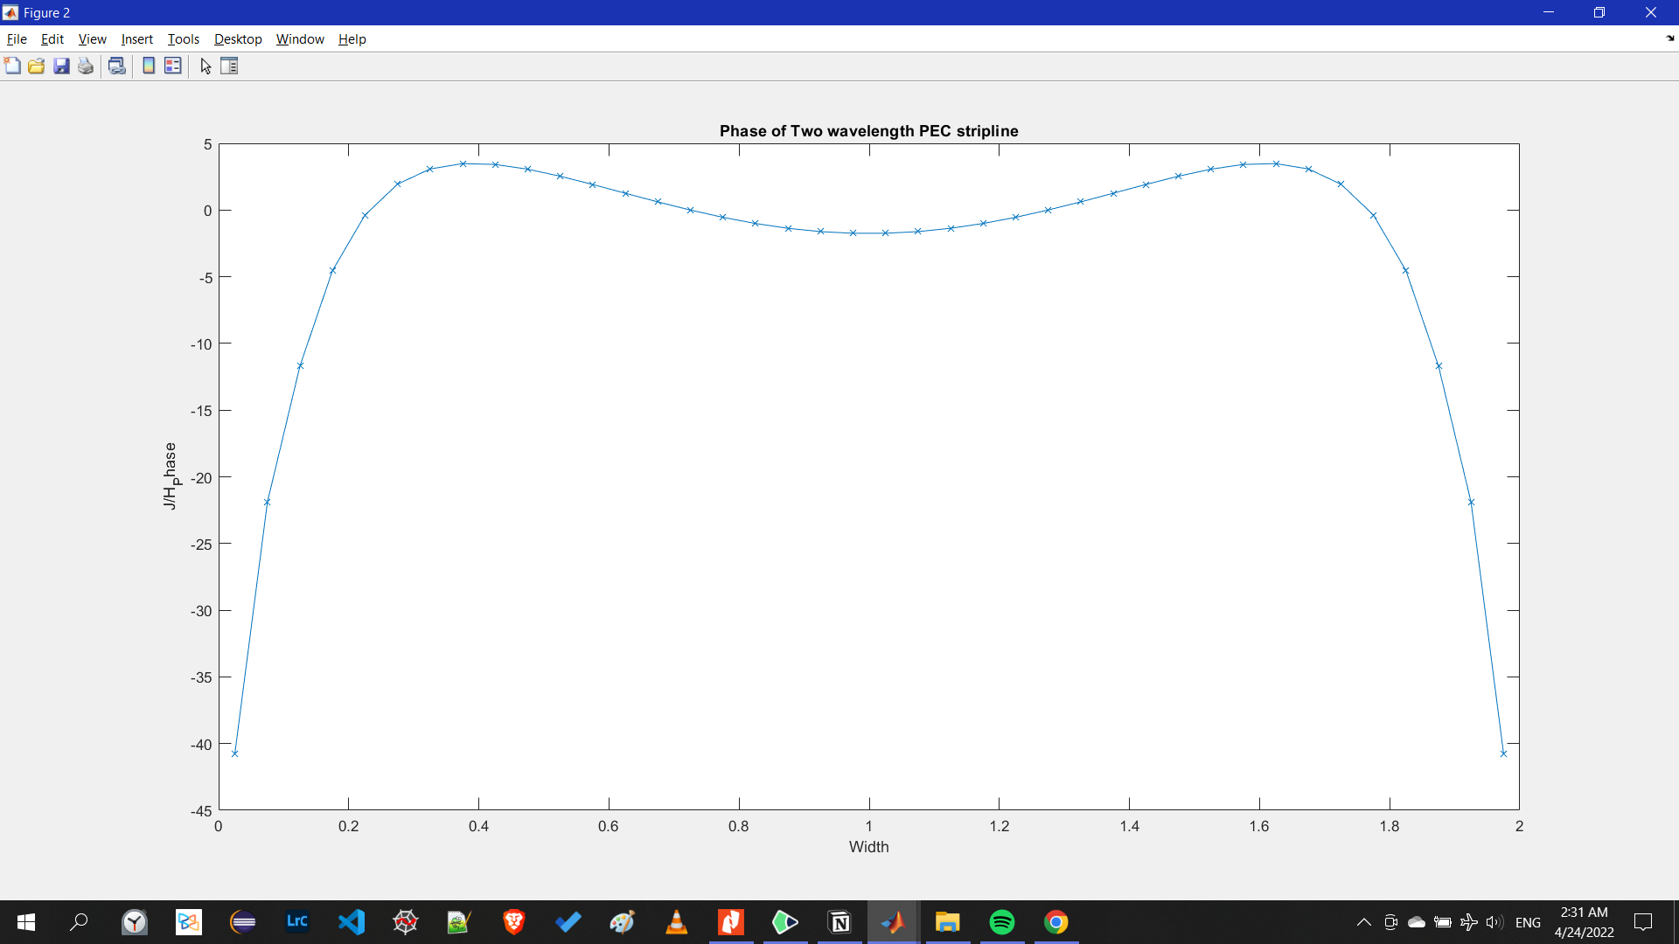
2D electromagnetic scattering from an arbitrary-shaped conducting object under TM illumination
Two Wavelength PEC:
Phase

Slide 33
VERY PERI
Introducing the Pantone Color of the Year 2022. PANTONE 17-3938 Very Peri is a dynamic hue that blends the faithfulness and constancy of blue with the energy and excitement of red.
The four color palettes in this template feature Very Peri to help you express your ideas and convey the right mood. Read on to learn how to use these colors in any presentation.
Assignment 3a
Microwave passive components

Slide 34
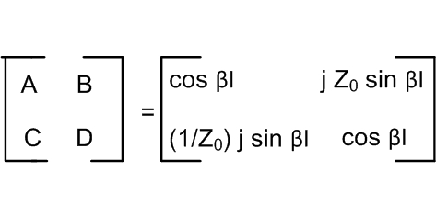
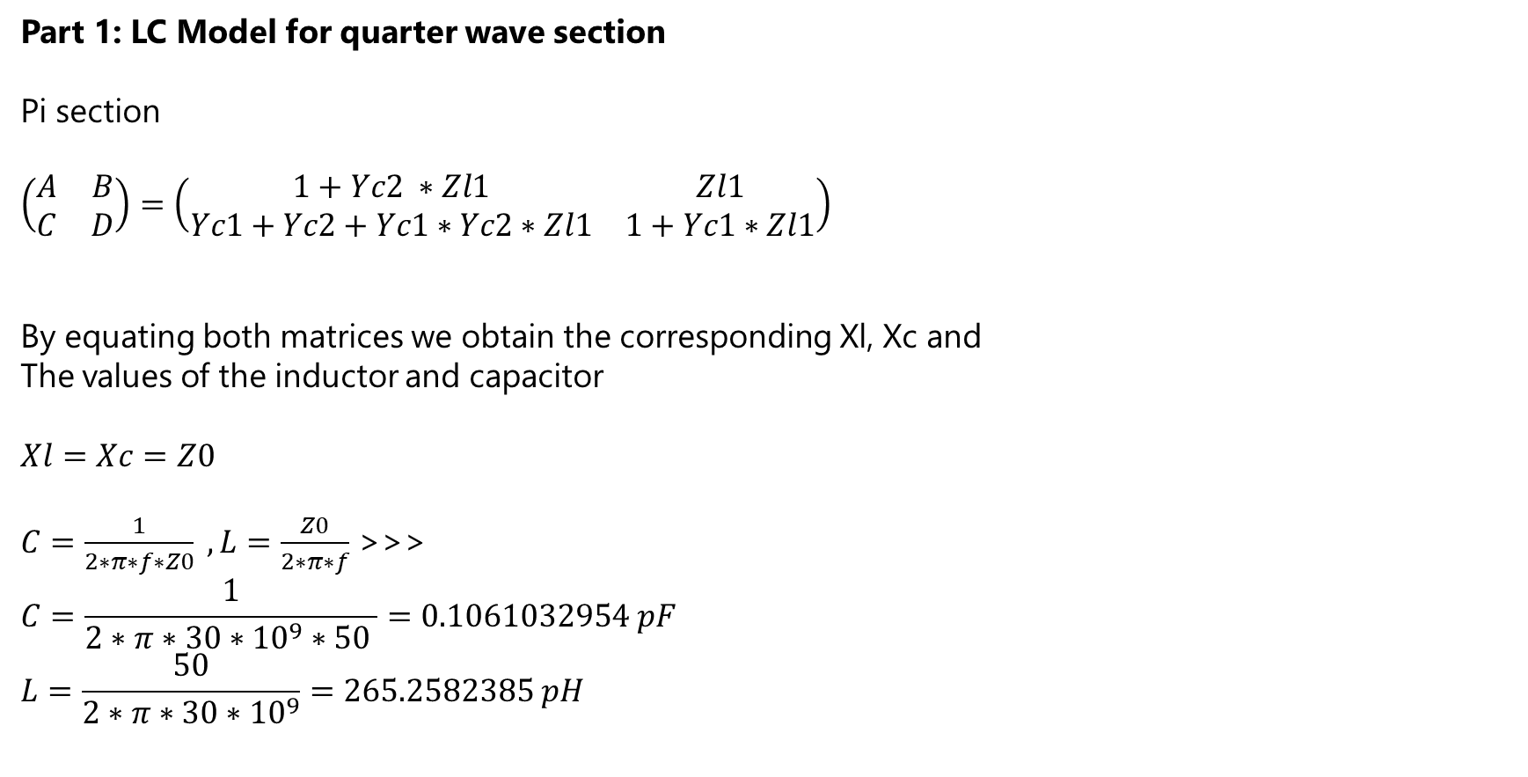
Wilkinson power splitter/combiner implementation
Part 1: LC Model for quarter wave section
Pi section
$$\left(\begin{matrix}A & B \\ C & D\end{matrix}\right)=\left(\begin{matrix}1+Yc2 ∗Zl1 & Zl1 \\ Yc1+Yc2+Yc1∗Yc2∗Zl1 & 1+Yc1∗Zl1\end{matrix}\right)$$
By equating both matrices we obtain the corresponding Xl, Xc and
The values of the inductor and capacitor
$$Xl=Xc=Z0$$
$C=\frac{1}{2∗π∗f∗Z0} , L=\frac{Z0}{2∗π∗f}$ >>>
$$C=\frac{1}{2∗π∗30∗{10}^{9}∗50 }=0.1061032954 pF$$
$$L=\frac{50}{2∗π∗30∗{10}^{9}}=265.2582385 pH$$

Slide 35
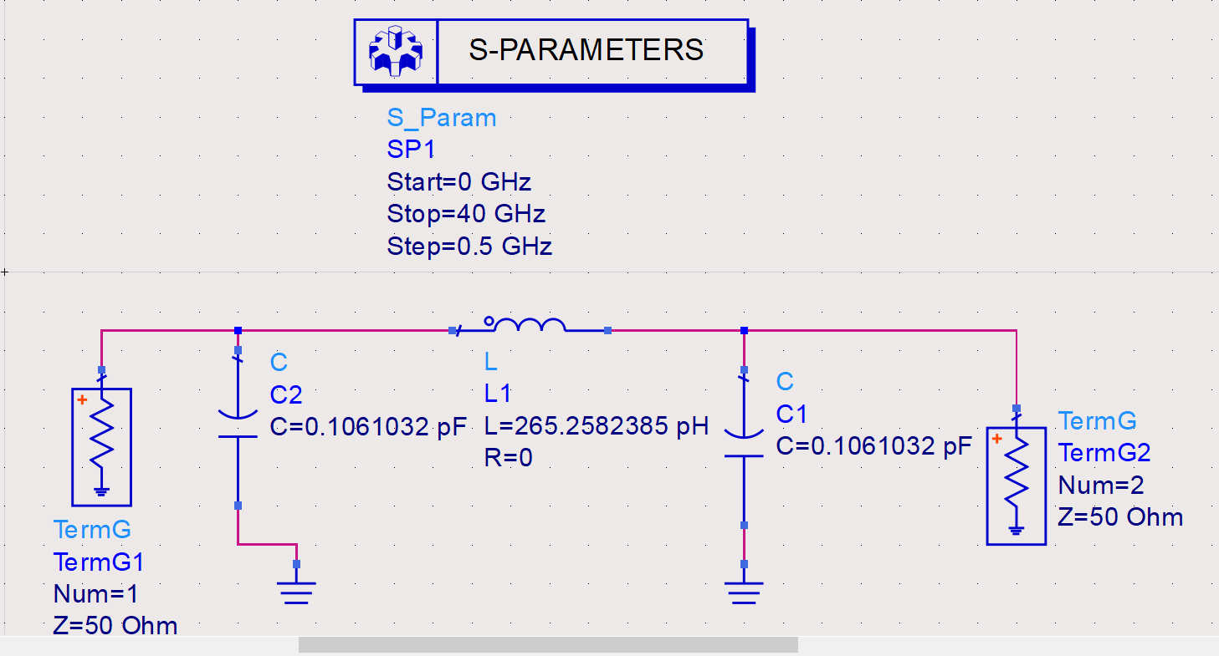
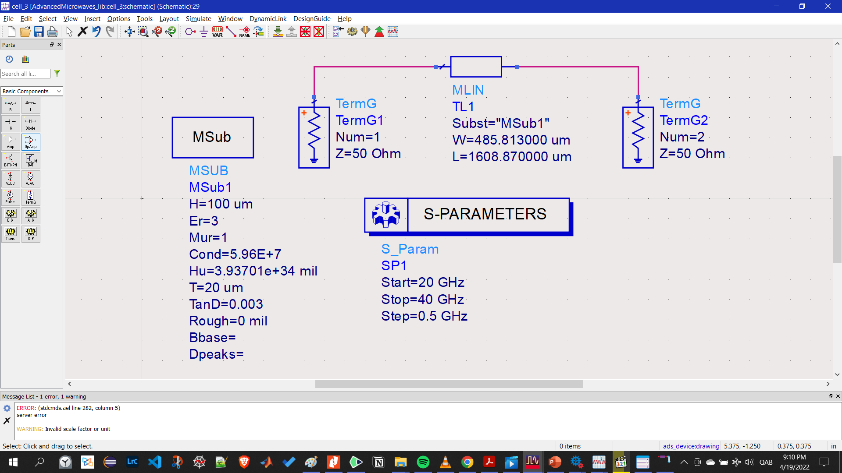
LC vs TL schematic design

Slide 36
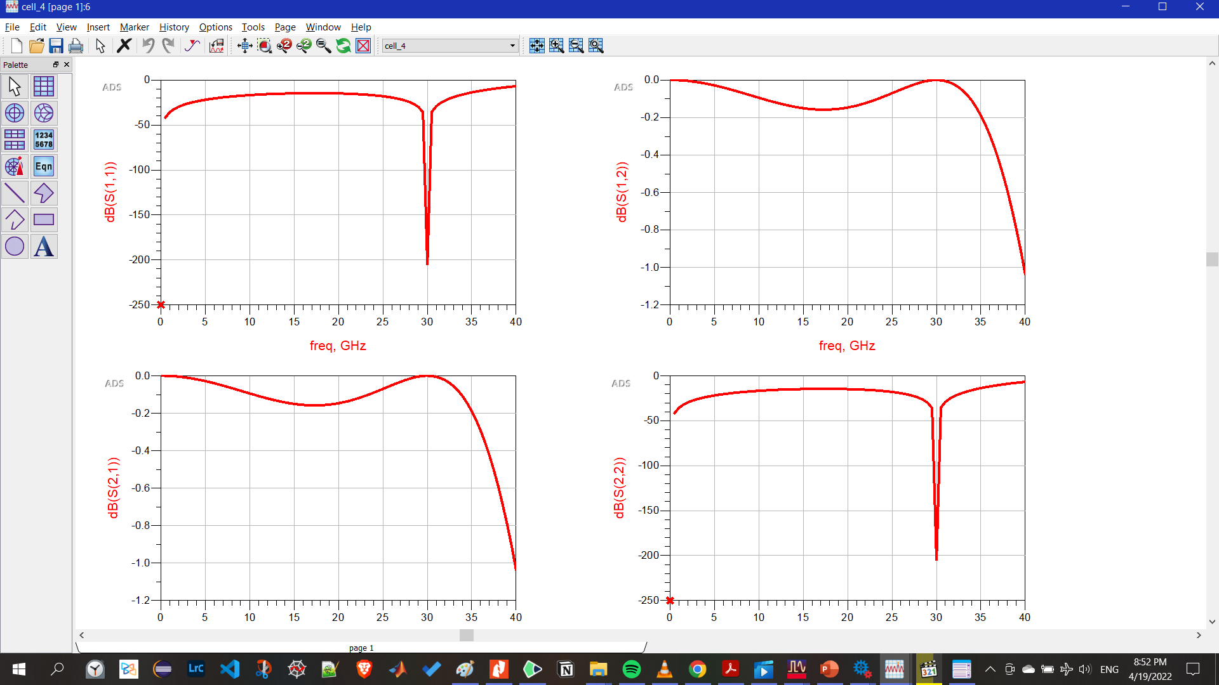
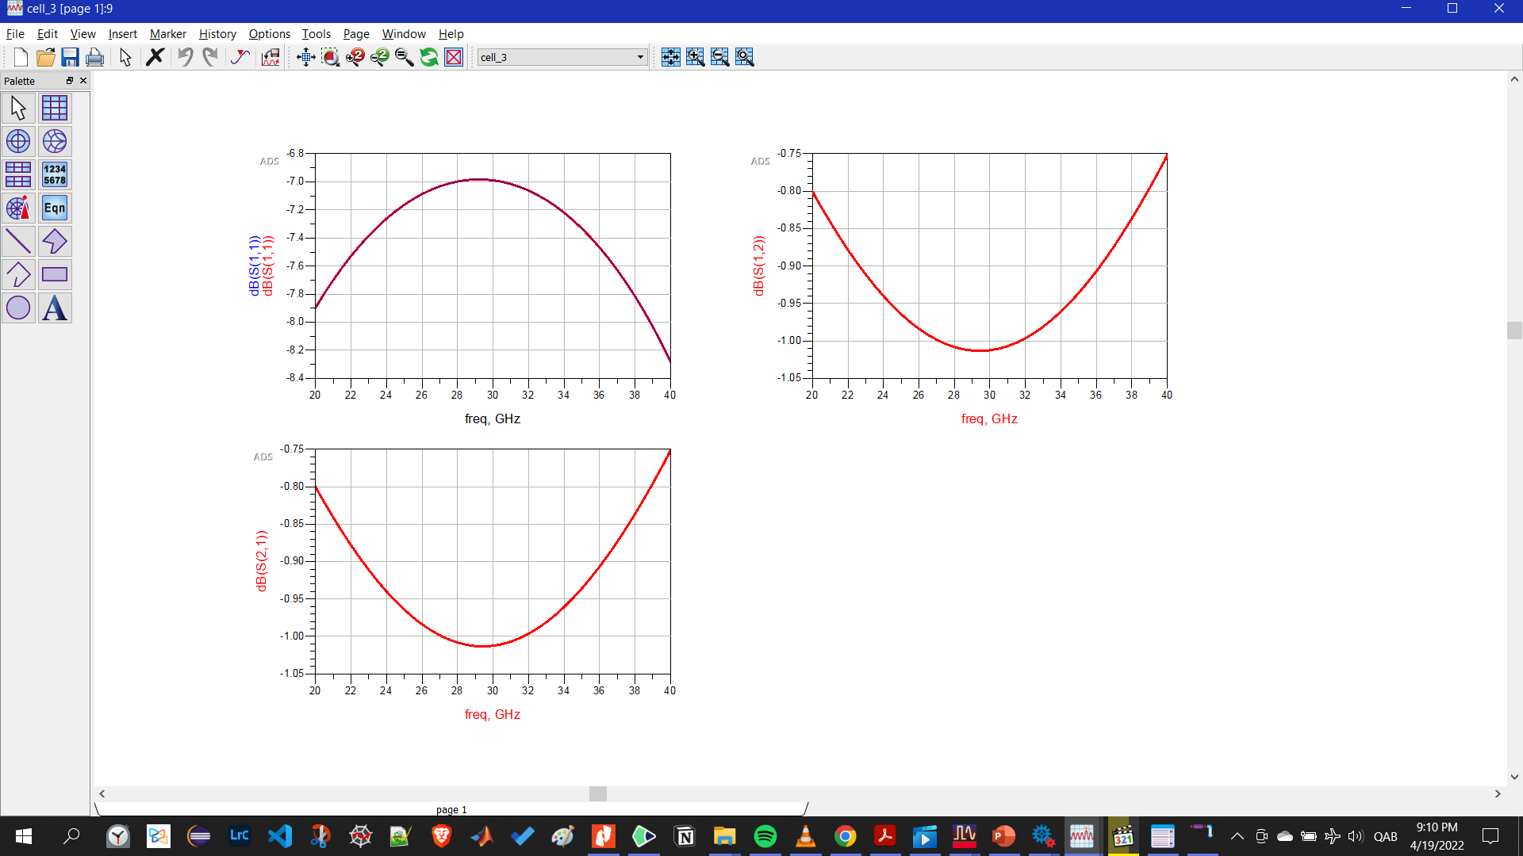
S11 LC vs tl
LC
TL

Slide 37
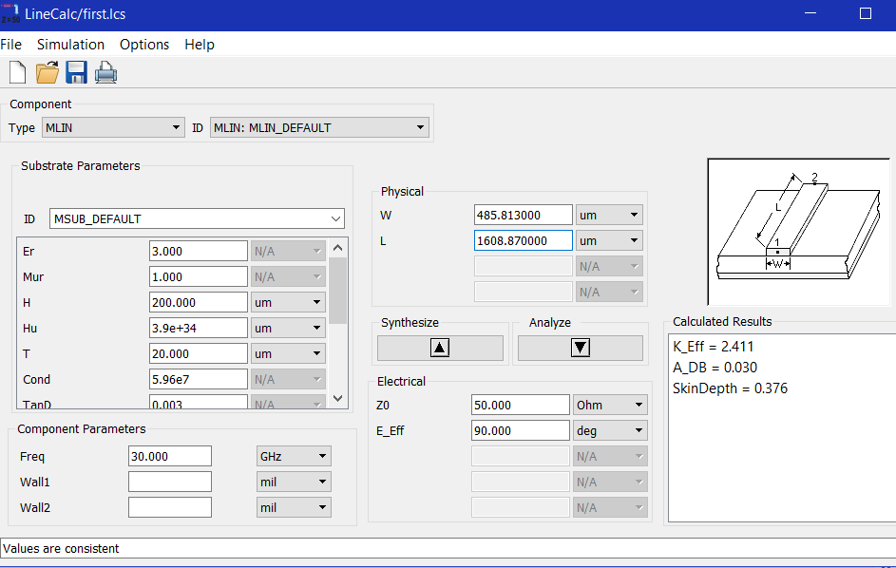
2-way Wilkinson

Slide 38
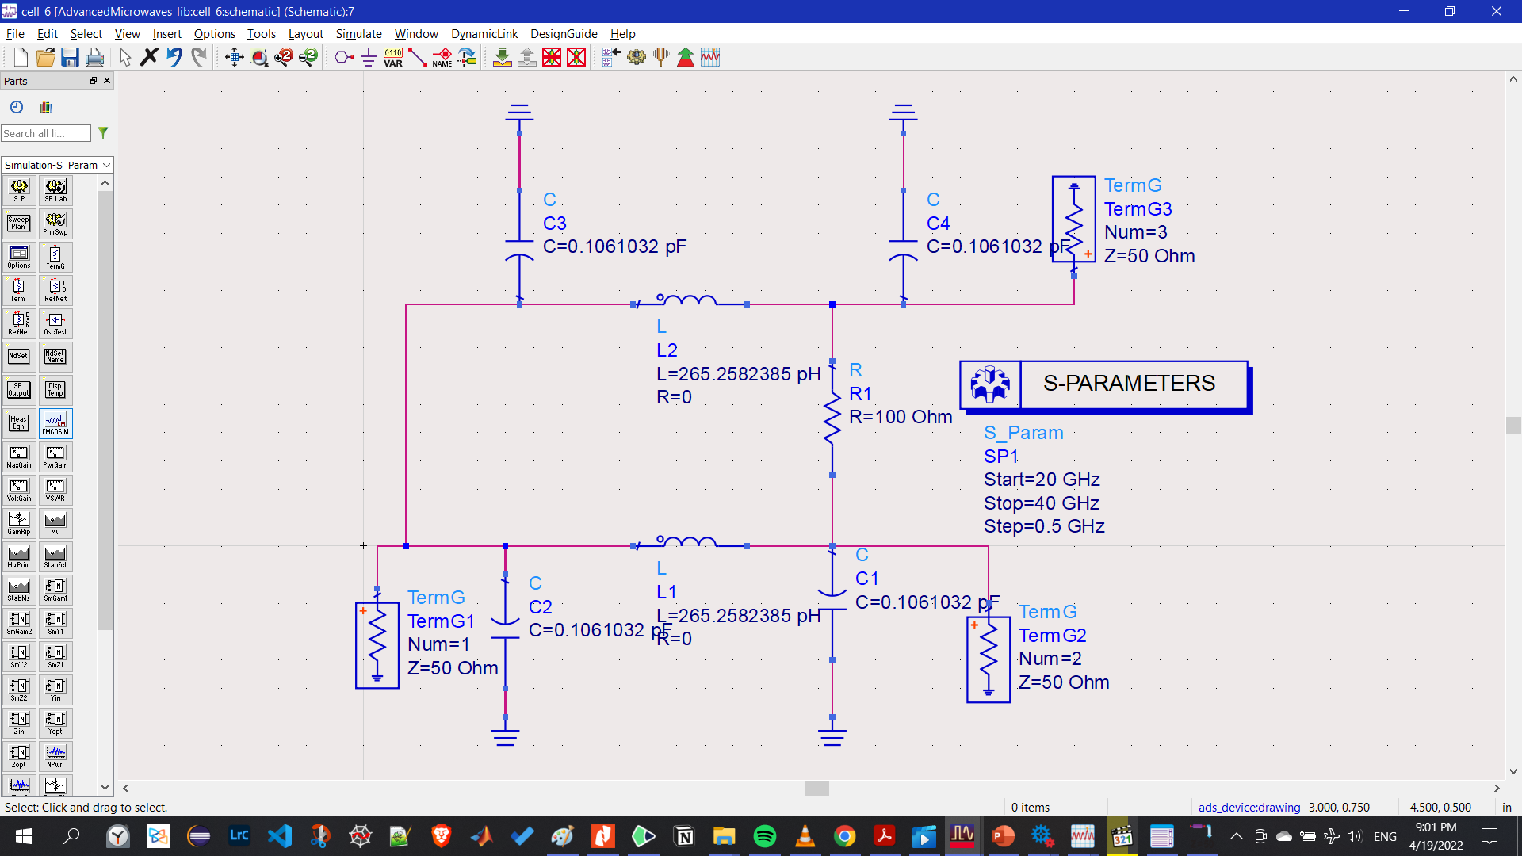
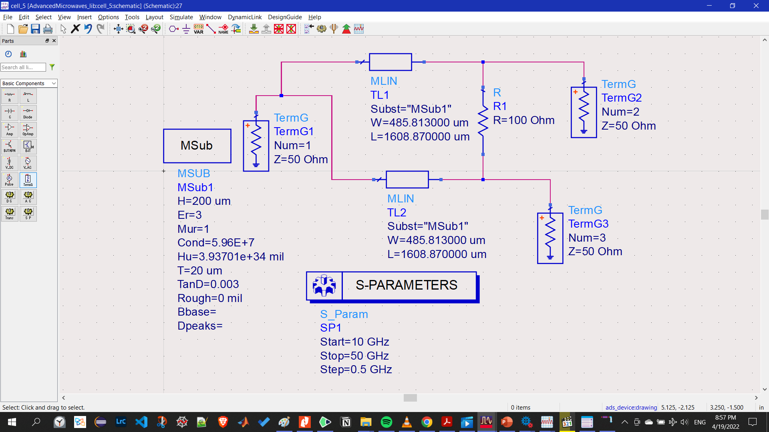
LC vs TL schematic design

Slide 39
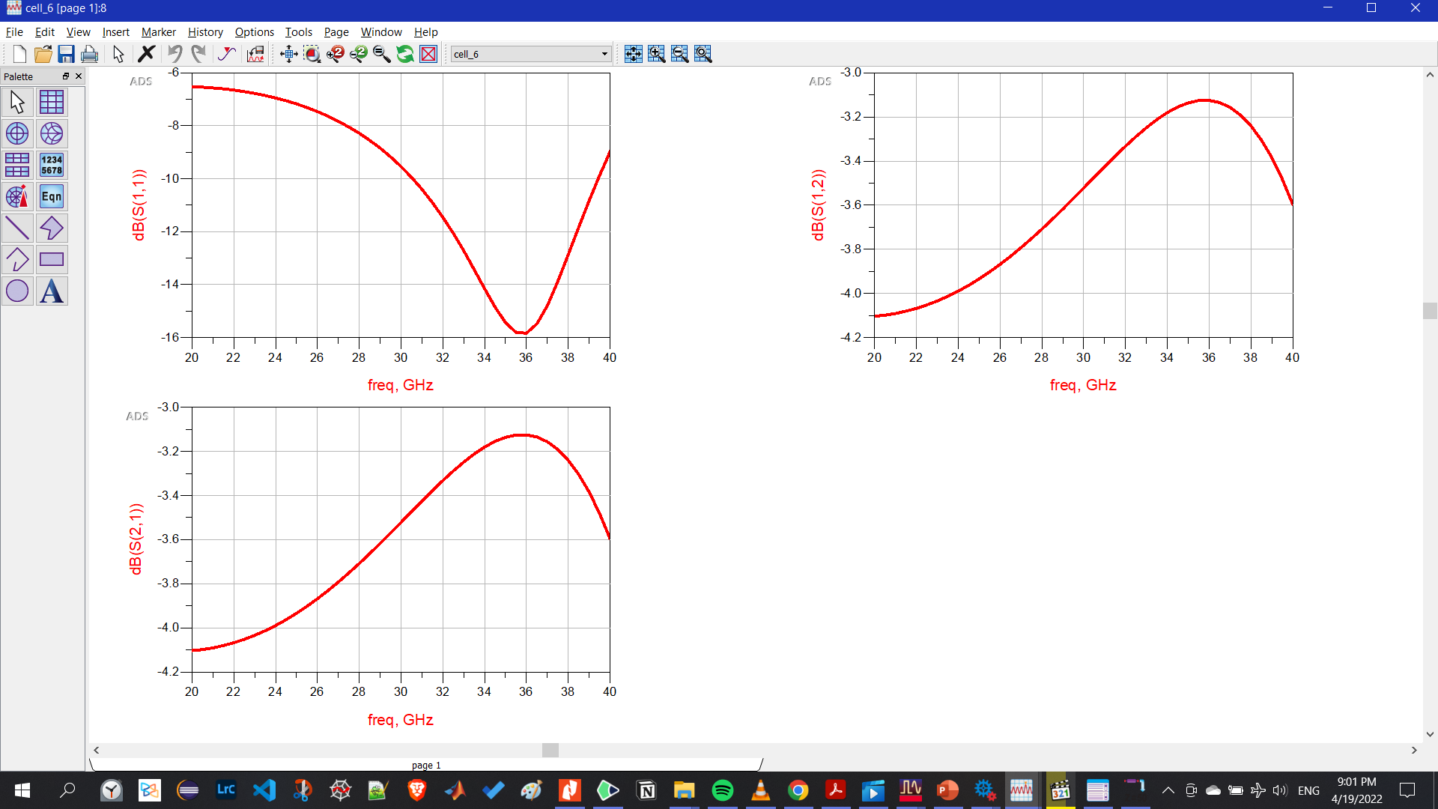
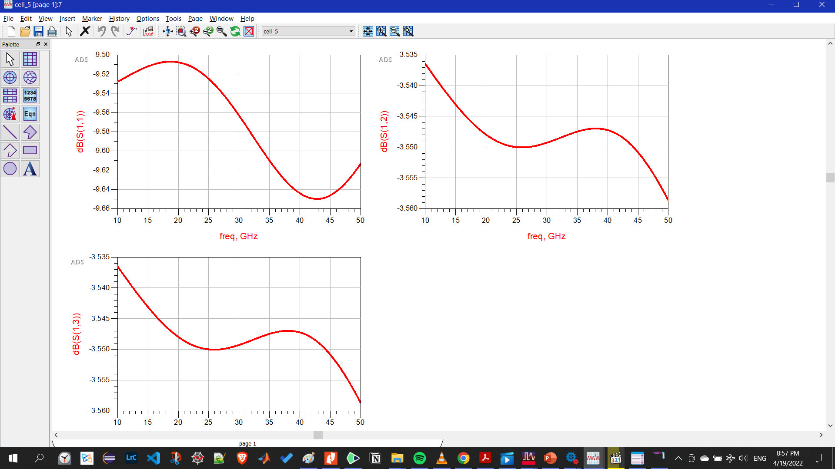
S11 LC vs tl
LC
TL

Slide 40
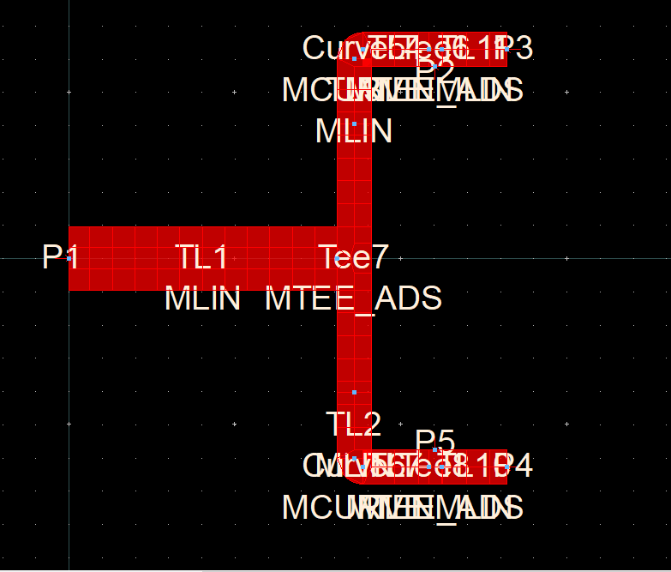
Wilkinson layout

Slide 41
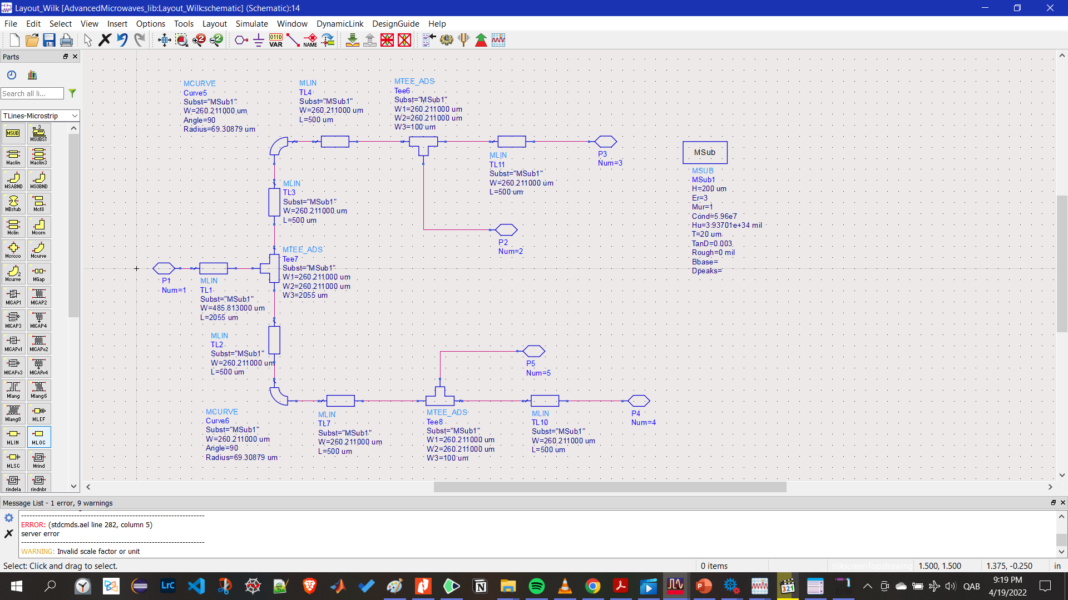
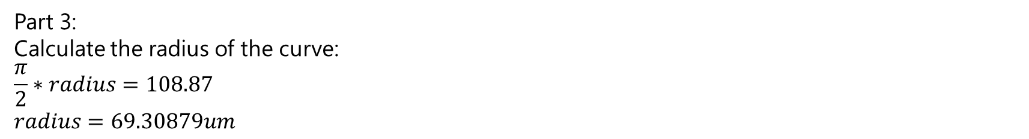
Part 3:
Calculate the radius of the curve:
$$\frac{π}{2}∗radius=108.87 \\ radius=69.30879um$$

Slide 42
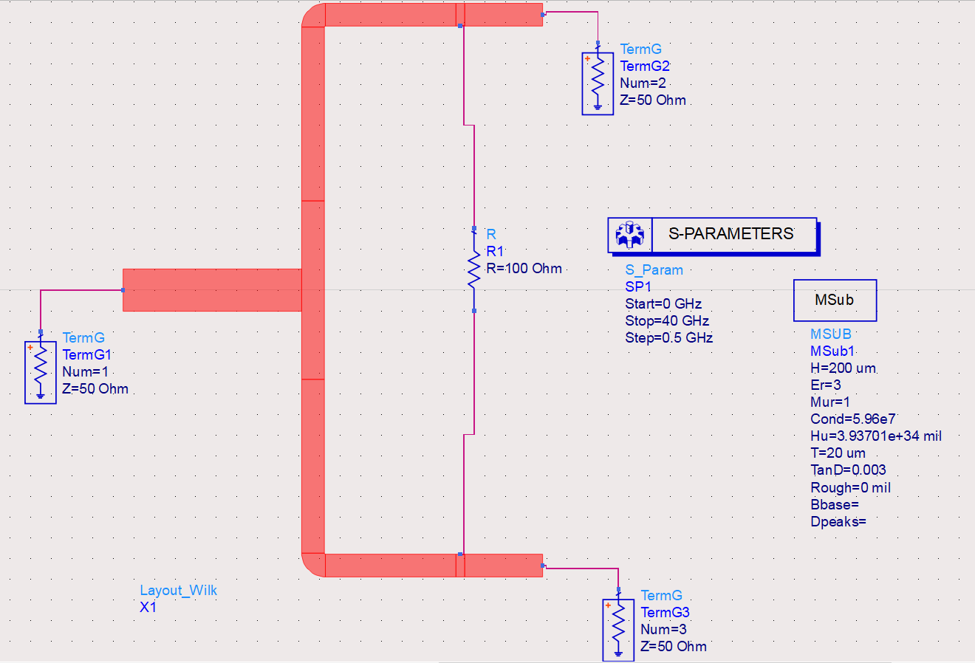
Layout added to schematic

Slide 43
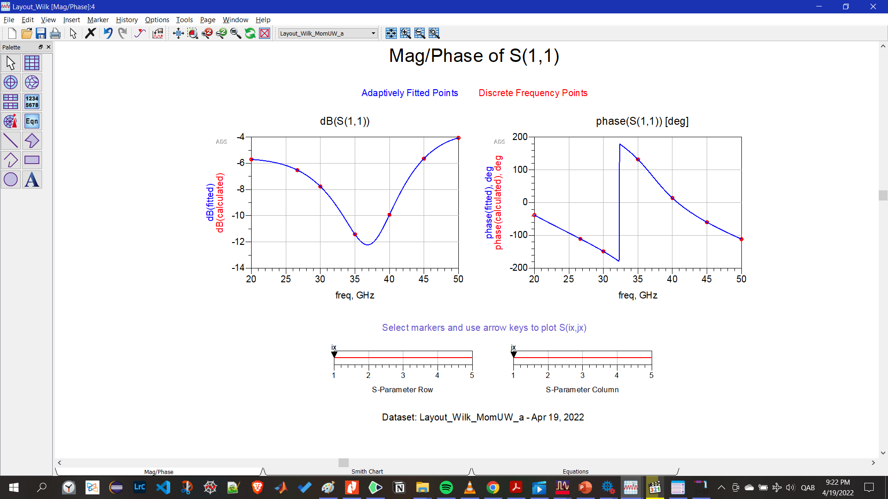
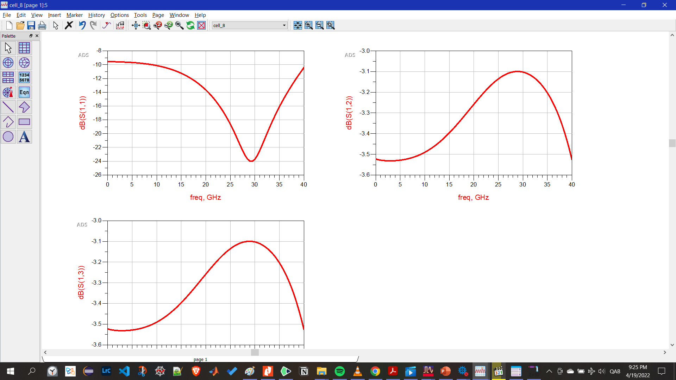
S11
From layout
S11
After adding layout to schematic
And the resistors

Slide 44
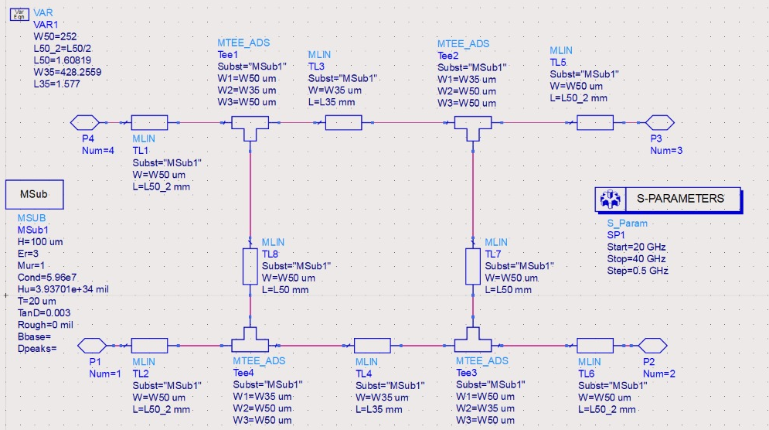
Part 2: Quadrature coupler implementation schematic

Slide 45
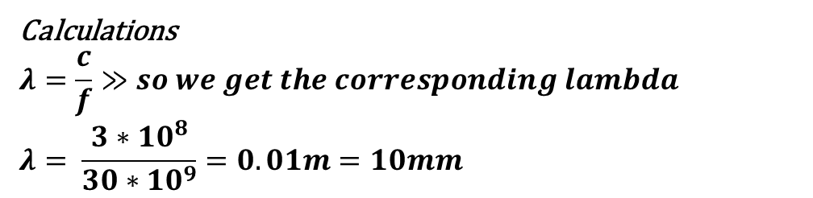
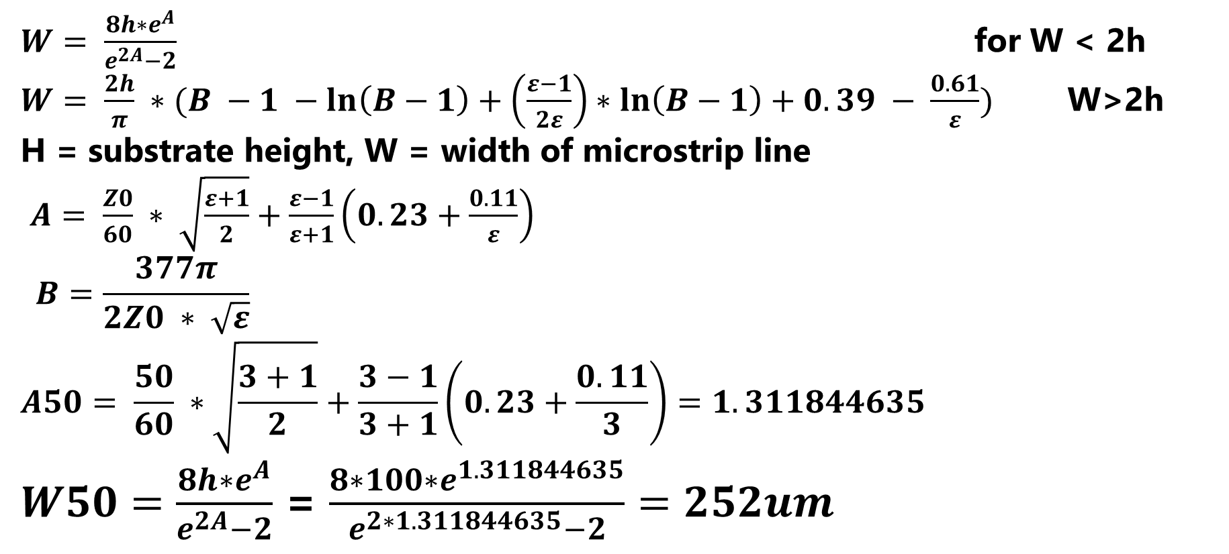
Calculations
$$λ=\frac{c}{f}≫so we get the corresponding lambda$$
$$λ= \frac{3∗10^{8}}{30∗10^{9}}=0.01m=10mm$$
$W= \frac{8h∗e^{A}}{e^{2A}−2}$ for W < 2h
$W= \frac{2h}{π} ∗(B −1 −\ln\left(B−1\right)+\left(\frac{ε−1}{2ε}\right)∗\ln\left(B−1\right)+0.39 − \frac{0.61}{ε})$ W>2h
H = substrate height, W = width of microstrip line
$A= \frac{Z0}{60} ∗ \sqrt{\frac{ε+1}{2}}+\frac{ε−1}{ε+1}\left(0.23+\frac{0.11}{ε}\right)$
$$B=\frac{377π}{2Z0 ∗ \sqrt{ε}}$$
$$A50= \frac{50}{60} ∗\sqrt{\frac{3+1}{2}}+\frac{3−1}{3+1}\left(0.23+\frac{0.11}{3}\right)=1.311844635$$
$W50=\frac{8h∗e^{A}}{e^{2A}−2}$ = $\frac{8∗100∗e^{1.311844635}}{e^{2∗1.311844635}−2}=252um$

Slide 46
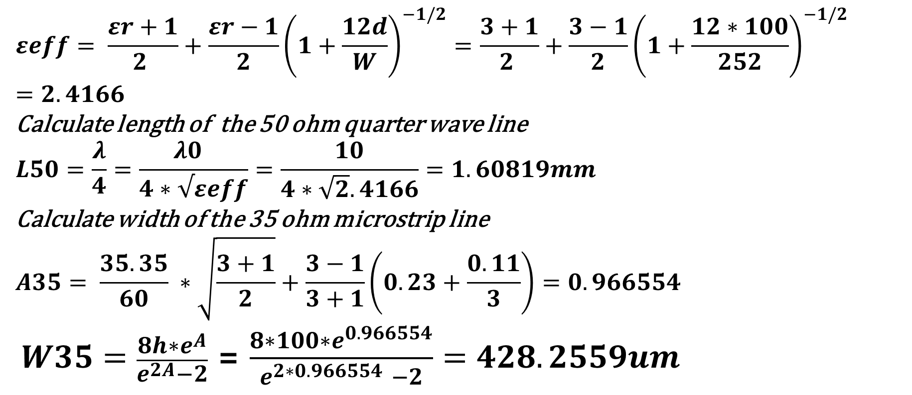
Calculate quarter wave length line
$$εeff= \frac{εr+1}{2 }+\frac{εr−1}{2}{\left(1+\frac{12d}{W}\right)}^{−1/2}=\frac{3+1}{2 }+\frac{3−1}{2}{\left(1+\frac{12∗100}{252}\right)}^{−1/2}=2.4166$$
Calculate length of the 50 ohm quarter wave line
$$L50=\frac{λ}{4}=\frac{λ0 }{4∗√εeff}=\frac{10}{4∗\sqrt{2}.4166}=1.60819mm$$
Calculate width of the 35 ohm microstrip line
$$A35= \frac{35.35}{60} ∗\sqrt{\frac{3+1}{2}}+\frac{3−1}{3+1}\left(0.23+\frac{0.11}{3}\right)=0.966554$$
$W35=\frac{8h∗e^{A}}{e^{2A}−2}$ = $\frac{8∗100∗e^{0.966554}}{e^{2∗0.966554 }−2}=428.2559um$

Slide 47
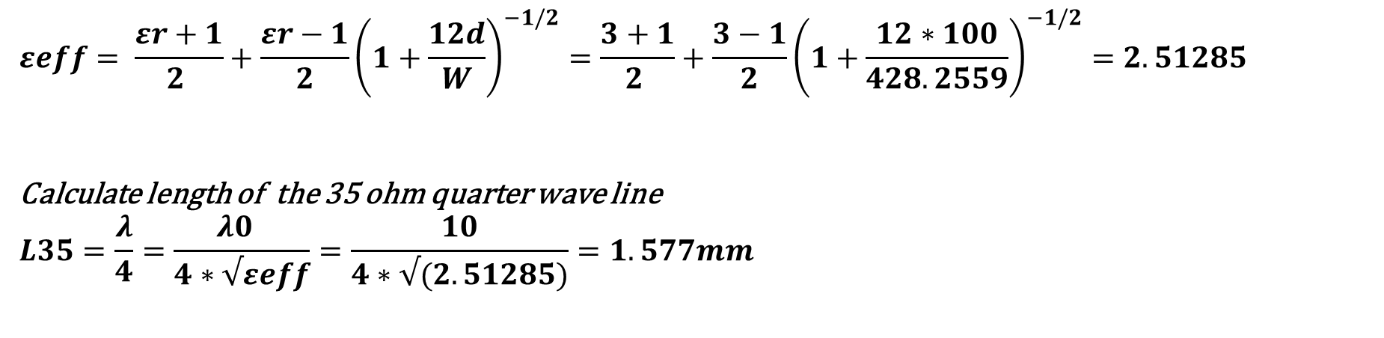
$$εeff= \frac{εr+1}{2 }+\frac{εr−1}{2}{\left(1+\frac{12d}{W}\right)}^{−1/2}=\frac{3+1}{2 }+\frac{3−1}{2}{\left(1+\frac{12∗100}{428.2559}\right)}^{−1/2}=2.51285$$
Calculate length of the 35 ohm quarter wave line
$$L35=\frac{λ}{4}=\frac{λ0 }{4∗√εeff}=\frac{10}{4∗√(2.51285)}=1.577mm$$

Slide 48

layout

Slide 49

S parameters for the coupler

Slide 50

S11 from layout

Slide 51

Part 3: balun implementation 1- High pass – low pass balun
Design Steps:
1- f0 = 60GHz
2- $X=\sqrt{R_{in}∗R_{L}}$
3- $L= \frac{X}{2∗π∗f_{0}} , C= \frac{1}{X∗2∗π∗f_{0}}$
I choose 60 GHz to test my 4 implementations
$$f_{0}=60 GHz≫X=50\sqrt{2}$$
$$L= \frac{50\sqrt{2}}{2∗π∗60 ∗{10}^{9}}=1.8756∗{10}^{−10}H,$$
$$C= \frac{1}{50\sqrt{2}∗2∗π∗60 ∗{10}^{9}}=3.75131∗{10}^{−14}F$$
The same technique goes for the 2.45 GHz to get the new L and C values

Slide 52

Part 3: balun implementation 1- High pass – low pass balun schematic

Slide 53

Part 3: balun implementation 1- High pass – low pass balun s parameters
60 GHz was a bad idea to test this implementation so I will test it on 2.45 GHz

Slide 54

Part 3: balun implementation 1- High pass – low pass balun schematic at f0 = 2.45 GHz
60 GHz was a bad idea to test this implementation so I will test it on 2.45 GHz

Slide 55

Part 3: balun implementation 1- High pass – low pass balun s parameters
60 GHz was a bad idea to test this implementation so I will test it on 2.45 GHz

Slide 56

Part 3: balun implementation 2- marchand balun

Slide 57

Part 3: balun implementation 2- marchand balun s parameters

Slide 58
Part 3: balun implementation 2- marchand balun s parameters s11

Slide 59

Part 3: balun implementation 2- marchand balun layout

Slide 60

Part 3: balun implementation 3- rat race balun to get the radius of the curves

Slide 61

Part 3: balun implementation 3- rat race balun to get the radius of the curves
R = length / 2*pi >> length calculated from the line calc
R = 4901.28 / 2*pi = 780.45859 um
Now we have the curves
We need to get the lines which have 50 ohm

Slide 62

Part 3: balun implementation 3- rat race balun schematic

Slide 63

Part 3: balun implementation 3- rat race balun layout

Slide 64

Part 3: balun implementation 3- rat race balun layout
At very high frequency rat race gives bad losses values
So I redesign at 2.45 GHz

Slide 65

Part 3: balun implementation 3- rat race balun line calc for Tl z0 = 50 ohm
At very high frequency rat race gives bad losses values
So I redesign at 2.45 GHz

Slide 66

Part 3: balun implementation 3- rat race balun line calc for Tl z0 =70.7 ohm
At very high frequency rat race gives bad losses values
So I redesign at 10 GHz
R = length / 2*pi >> length calculated from the line calc
R = 29908.9 / 2*pi = 4760.15 um
Now we have the curves
We need to get the lines which have 50 ohm

Slide 67

Part 3: balun implementation 3- rat race balun schematic at f0 = 10 GHz

Slide 68

Part 3: balun implementation 3- rat race balun layout at f0 = 10 ghz

Slide 69

Part 3: balun implementation 3- rat race balun layout s parameters at f0 = 10GHz

Slide 70

Part 3: balun implementation 3- rat race balun layout s11
At very high frequency rat race gives bad losses values
So I redesign at 10 GHz

Slide 71

Part 3: balun implementation 4- transformer based balun

Slide 72

Part 3: balun implementation 4- transformer based balun s parameters

Slide 73
Part 3: balun implementation 4- transformer based balun s parameters s11

Slide 74
VERY PERI
Introducing the Pantone Color of the Year 2022. PANTONE 17-3938 Very Peri is a dynamic hue that blends the faithfulness and constancy of blue with the energy and excitement of red.
The four color palettes in this template feature Very Peri to help you express your ideas and convey the right mood. Read on to learn how to use these colors in any presentation.
Assignment 3b
Beam-Squint in Phased Arrays

Slide 75

derivation

Slide 76



derivation
From the SF equation
$$β=k ∗d ∗sin⁡(θ)$$
$$β=\frac{2∗π ∗d}{c}∗\left(f_{0 }+ \frac{∆f}{2}\right)∗\sin\left(θ\right)$$
To derive the expression we want to know where the grating loops appear
$$∆∅= \frac{2πdsin(θ)}{λ}$$
we can compute the beam angle as a function of phase shift
$$θ=\arcsin\left(\frac{∆∅}{2π}∗\frac{λ}{d}\right)$$
$$θ=\arcsin\left(\frac{m∗2π+∆∅}{2π}∗\frac{λ}{d}\right)$$
To avoid grating lobes, our goal is to obtain a single real solution
$\left|\frac{m∗2π+∆∅}{2π}∗\frac{λ}{d}\right|$ > 1 for all m >= 1
$θ=\arcsin\left(m∗\frac{λ}{d}\right)$ for $∆∅$=0

Slide 77



derivation
From the SF equation
$$β=k ∗d ∗sin⁡(θ)$$
$\frac{m∗2π+∆∅}{2π}∗\frac{λ}{d}will range from 0 to 0.5∗$ $\frac{λ}{d}$ for m = 0
$$θ=\arcsin\left(\frac{m∗2π+∆∅}{2π}∗\frac{λ}{d}\right)$$
To avoid grating lobes, our goal is to obtain a single real solution
$\left|\frac{m∗2π+∆∅}{2π}∗\frac{λ}{d}\right|$ > 1 for all m >= 1
$θ=\arcsin\left(m∗\frac{λ}{d}\right)$ for $∆∅$=0
$$∆θ=\arcsin\left(\frac{f_{0}}{f}\sin\left(θ_{0}\right)\right)−θ_{0}$$
The beam squint, or deviation in
steering angle vs. frequency, is
caused by approximating a time
delay with a phase shift.
Implementing beam steering with
true time-delay units doesn’t
have this problem

Slide 78

plot

Slide 79
VERY PERI
Introducing the Pantone Color of the Year 2022. PANTONE 17-3938 Very Peri is a dynamic hue that blends the faithfulness and constancy of blue with the energy and excitement of red.
The four color palettes in this template feature Very Peri to help you express your ideas and convey the right mood. Read on to learn how to use these colors in any presentation.
Assignment 4a
The Insertion Loss Method

Slide 80

Schematic Design

Slide 81

S Parameters

Slide 82

Attenuation s21

Slide 83
VERY PERI
Introducing the Pantone Color of the Year 2022. PANTONE 17-3938 Very Peri is a dynamic hue that blends the faithfulness and constancy of blue with the energy and excitement of red.
The four color palettes in this template feature Very Peri to help you express your ideas and convey the right mood. Read on to learn how to use these colors in any presentation.
Assignment 4b
Coupled-Resonator Filters

Slide 84

Line calc z0=50 ohm example 1 BANDSTOP FILTER

Slide 85


Line calc z0 = 265.9 and 387

Slide 86

Schematic design

Slide 87

S parameters from schematic

Slide 88

Attenuation from schematic s21

Slide 89

layout design

Slide 90

S parameters from layout

Slide 91

Attenuation from layout s21

Slide 92
Line calc z0=50 ohm example 2 BANDPASS FILTER

Slide 93


example 2 BANDPASS FILTER
Line calc z0=50 ohm and theta = 166.5
Line calc z0=50 ohm and theta = 155.8

Slide 94

Example 2 constrains:
F1 = 1.8 GHz
Fc = 2 GHz
F2 = 2.2 GHz
Z0 = 50 ohm
Attenuation(alpha) = 20 dB at 2.2 GHz Delta = (f2-f1) / fc = 0.4/2 = 0.2
Filter order = 3
Number of sections 4

Slide 95

Example 2 schematic using tl model:

Slide 96

S parameters from schematic

Slide 97
Attenuation from schematic s21
From marker number 3 at frequency = 2.2 GHz it is achieved that attenuation is -20 dB

Slide 98

layout
I wasn’t able to get the right values from the layout

Slide 99

S parameters from layout
I wasn’t able to get the right values from the layout

Slide 100

Schematic using the coupled lines

Slide 101

S parameters from Schematic using the coupled lines

Slide 102
Attenuation from Schematic using the coupled lines s21

